Slide 1
Practical Path Guiding for Efficient Light Transport Simulation
Thomas Müller
Markus Gross
Jan Novák
Notes:
Hello everyone, I’m Thomas and I’m going to be talking about Practical Path Guiding for Efficient Light-Transport Simulation.

Slide 2
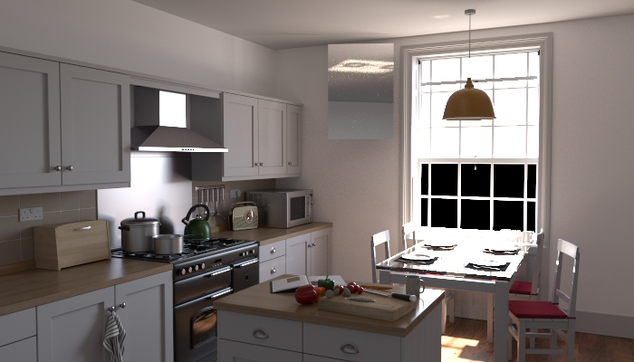
Modified Country Kitchen by Jay-Artist – CC BY 3.0
Notes:
Our goal is to generate photorealistic images like this one here via path tracing.

Slide 3



Path Tracing Review: BSDF importance Sampling
BSDF
$$x$$
Notes:
I’d like to begin with a brief review of how paths are usually constructed. When hitting a surface at some location we take into account its material via the BSDF. We sample directions according to the BSDF’s magnitude, like so.

Slide 4


Path Tracing Review: Direct Illumination Sampling
Multiple Importance Sampling
[Veach 1995]
BSDF
Next Event Estimation
$$x$$
Notes:
Now the BSDF is not everything. We also need to consider the directions where light comes from in the first place. Unlike with BSDF sampling, we usually do not have a closed form technique for sampling incident illumination. In practice, what’s commonly done is to directly connect the shading location with an emitter. This is called next event estimation.
BSDF sampling and next event estimation can be can then be combined with multiple importance sampling, and this gives us a traditional baseline path tracer.

Slide 5


Path Tracing Review: Indirect Illumination
Indirect illumination matters!
(Sometimes a lot!)
Let’s try to importance sample it!
$L\left(x,ω_{i}\right)$
Incident
$$x$$
Notes:
Let’s have a look at where this path tracer can fail.
We put a reflector here, and we place an occluder right in front of the light source. First of all, this blocks all direct illumination from before.
However, by adding the reflector, suddenly these new light paths contribute illumination to our shading location.
If we were to plot the incident radiance function it might look something like this.
We conclude: Indirect illumination matters. And sometimes, like here, it matters a lot. So, would it be possible to importance sample the full incident illumination function, rather than just direct illumination? Doing so is precisely what we would like to achieve with path guiding.

Slide 6
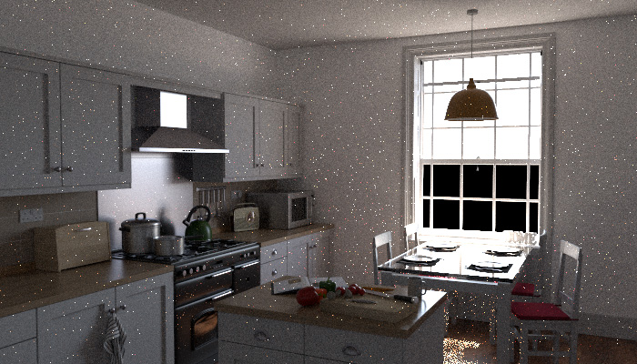
Path Tracing
Notes:
Let’s illustrate this with a real-world example. Here we have a simple kitchen scene with a glass table, and the mere presence of this mundane glass table completely breaks the efficiency our standard path tracer from before, this is particularly noticeable under the table itself.
There are more sophisticated path tracing algorithms like bidirectional path tracing which can do a better job at this.

Slide 7
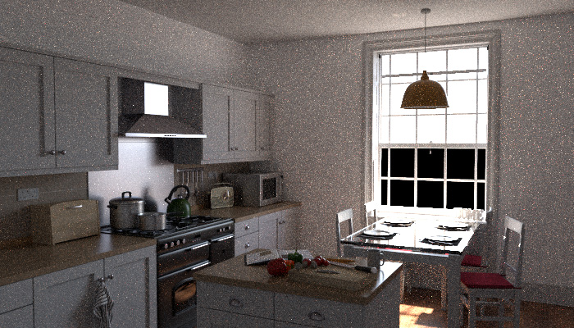
Bidirectional Path Tracing
Notes:
But what happens when we add another mundane object to our kitchen. Say… a conveniently placed mirror which should reveal a caustic on the ceiling…

Slide 8
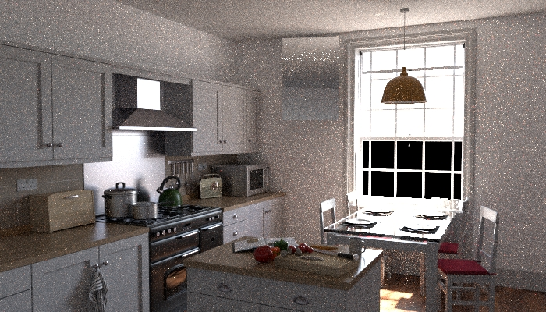
Bidirectional Path Tracing
Notes:
Only, that with bidirectional path tracing instead of a caustic we just get a bunch of fireflies.
Let me show you what our guided unidirectional path tracer produces in this scene.

Slide 9

Our Path Guiding
Notes:
Despite the few remaining fireflies, the caustic is revealed and the overall noise is dramatically reduced. So with path guiding, even unidirectional path tracing can robustly handle caustics and SDS light paths well.

Slide 10
How to Obtain the Incident Radiance for Guiding?
How to compute L?
Jensen [1995]: Use the photon map
Vorba et al. [2014]: Also use importons
Ours: Unidirectional Path Tracing
How to store L?
$L\left(x,ω_{i}\right)$
Incident
$$x$$
Notes:
I’d like to first consider the problem of how we can compute the incident radiance L in the first place.
More than 20 years ago, as the first person to implement a path guiding algorithm, Jensen proposed to read it off from his photon map.
A bunch of variations and improvements to his initial technique followed, until about 3 years ago, Vorba et al. introduced the additional usage of importons in an iterative ping-pong optimization scheme which---in combination with their other great additions---drastically improved upon previous work.
Unlike most previous work, we precompute L unidirectionally using path tracing. We cache radiance estimates at each path vertex, and we use those to populate our guiding distributions.
Thanks to our data structure and the iterated scheme we propose, we are able to obtain results which are on par or better than bidirectional techniques.
I’ll go into more detail about how our iterative approach works later on, and for now I’ll focus on how we store L.

Slide 11
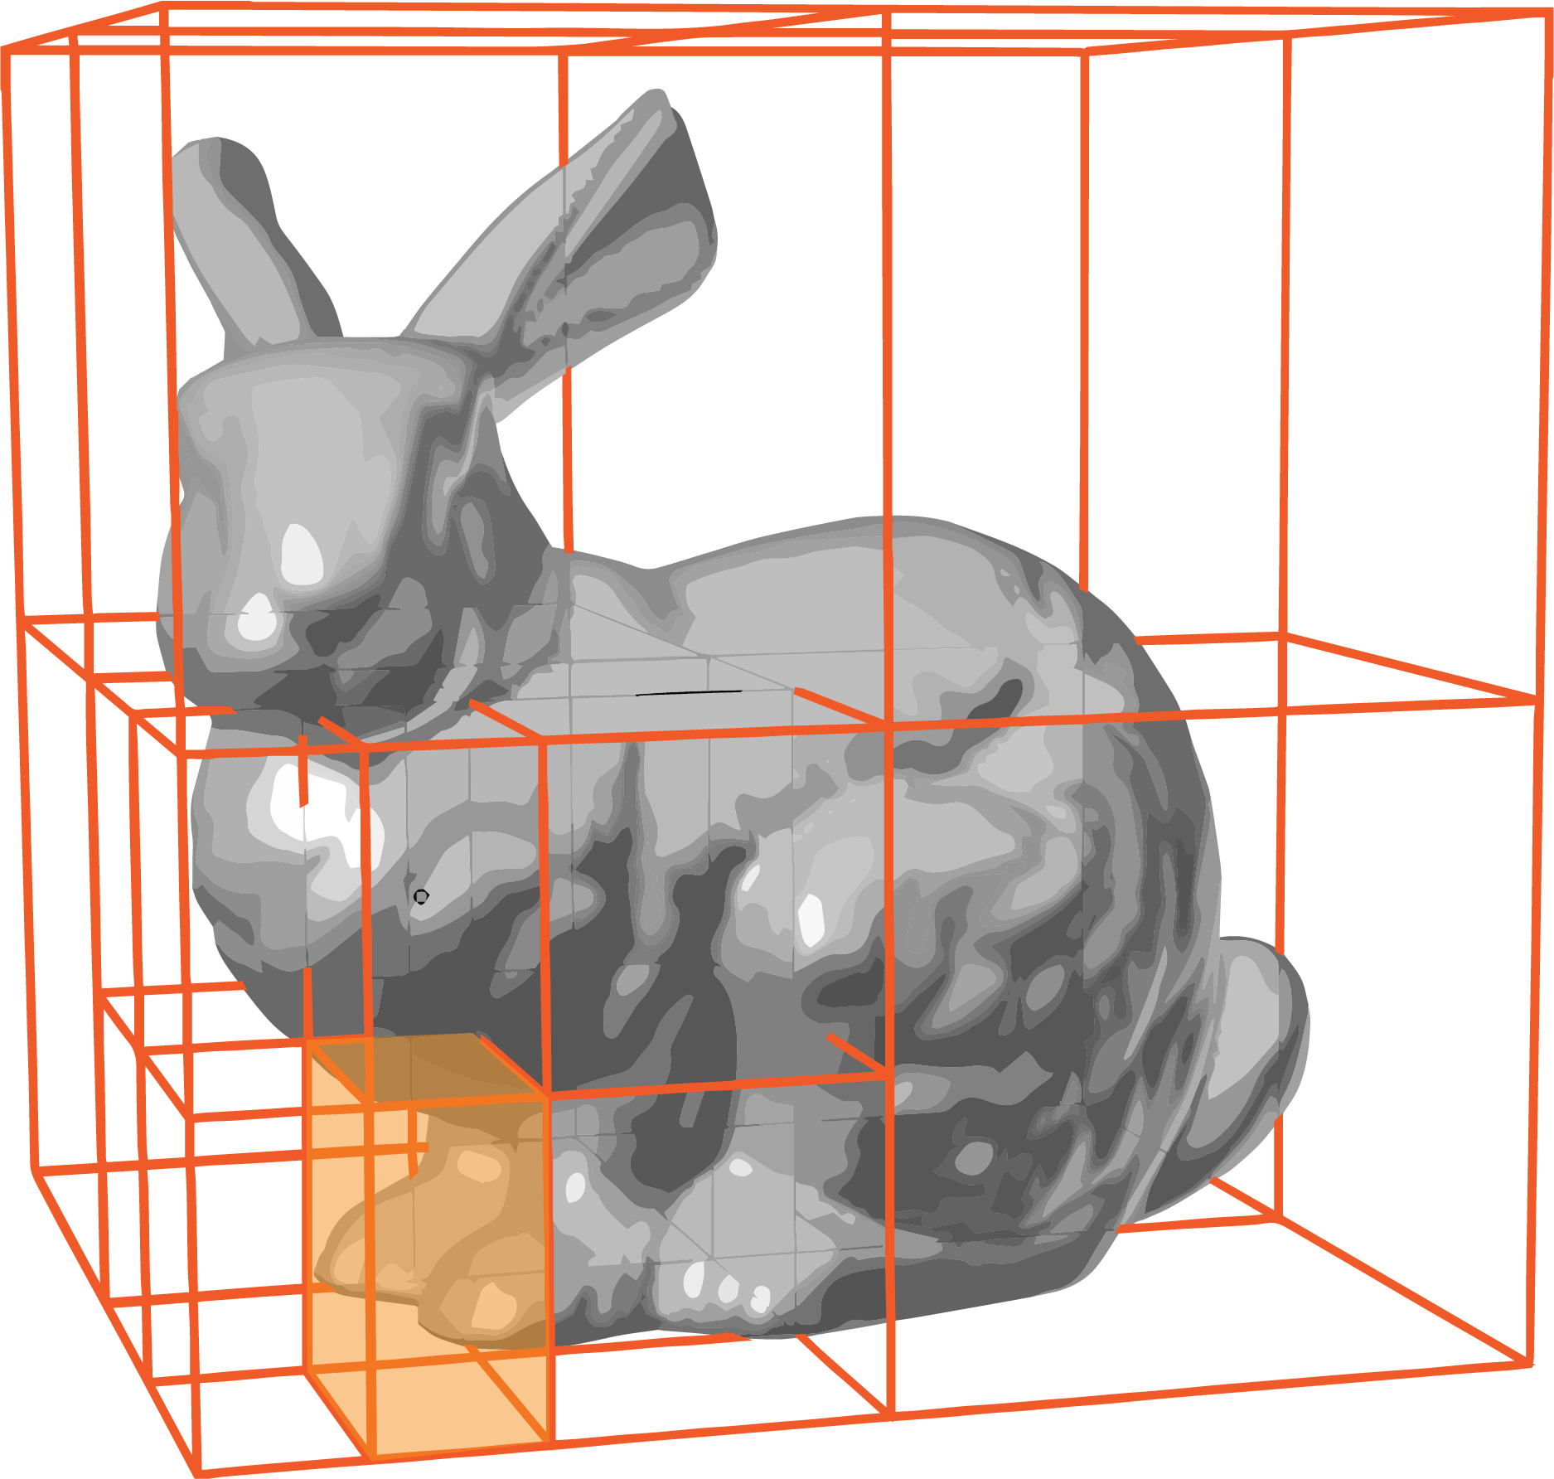


Storing the Guiding Distribution
$L\left(x,ω_{i}\right)$
Incident
$$x$$
Notes:
The incident radiance function is a light field. It has a spatial and a directional component.
We put the spatial component into an adaptively refined binary tree that spans the scene volume. Building the spatial tree is relatively straightforward, and therefore, in this presentation, I’ll only cover the directional component which was a bit more tricky for us to get right and I believe is more interesting.

Slide 12


Storing the Guiding Distribution
Cylindrical coordinates
$L\left(x,ω_{i}\right)$
Incident
$$x$$
Notes:
We parametrize directions in terms of cylindrical coordinates and squish them a bit to get them in this nice 2D square domain. The main question here is: How do we discretize this 2D domain in a smart way.

Slide 13
Storing the Guiding Distribution
Jensen’s [1995] approach:
Regular Grid
No adaptivity = High memory + overfitting
$L\left(x,ω_{i}\right)$
Incident
$$x$$
Notes:
Let’s first look at how Jensen did it originally. He simply stored his photons in a regular grid. Now if we wanted to have a higher resolution in this red region, maybe because more photons happened to be there, then we’d need to increase the resolution everywhere. This leads not only to excessive memory usage, but also to overfitting because in some regions there will be too few photons to properly populate the high-resolution grid.
In conclusion, a regular grid is not suitable. Something adaptive is needed.

Slide 14



Storing the Guiding Distribution
Vorba et al. [2014] approach:
Gaussian Mixture Model
Very adaptive!
Low memory usage
Expectation Maximization:
Robustness issues
$L\left(x,ω_{i}\right)$
Incident
$$x$$
Notes:
Vorba et al. also recognized the problem of adaptivity, and so they propose to represent the function as a mixture of gaussian distributions, which they train in an iterative manner.
These gaussians are extremely adaptive, which leads to a very low memory usage, and a good fit to high-frequency features.
There is just one problem: As commonly done, the gaussians are trained with the expectation maximization algorithm, which only converges to local optima. So even if there was noise-free input---which there never is---there is still no guarantee for a good fit. We found that in some cases this leads to robustness issues.

Slide 15
Storing the Guiding Distribution
Our approach:
Quadtree
Still adaptive!
Still low memory usage!
Robust construction
$L\left(x,ω_{i}\right)$
Incident
$$x$$
Notes:
Since we like the adaptivity of the gaussian mixtures, but we also want the robustness of a grid-like structure, we chose something inbetween. We use a quadtree, which we refine in an adaptive fashion within our own iterated training approach.
This data structure retains adaptivity and also low memory, although, admittedly, the memory usage of one of our quadtrees it is a bit higher than the memory usage of one of Vorba’s gaussian mixture models.
The big selling point here is that in contrast to the expectation maximization algorithm the precomputation for a given quadtree converges to the global optimum, and in fact equals the optimum in expectation.

Slide 16
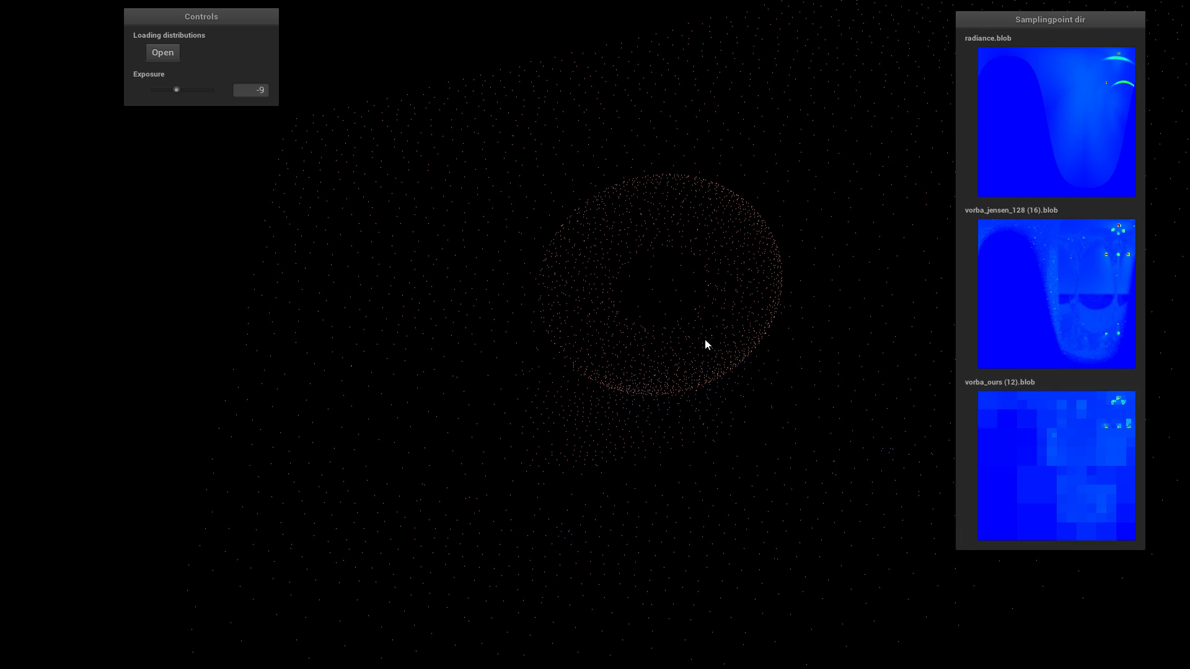
Storing the Guiding Distribution
GMMs [Vorba et al. 2014]:
Reference:
Our quadtrees:
Notes:
Here I am comparing directional components guiding distributions from an actual rendering at an oscillating spatial location.
On the left we have the gaussian mixtures by Vorba et al., in the middle we have a reference solution on a regular grid, and on the right there are our quadtrees.
Have a look at the top of these distributions. The red peaks indicate distinct modes of large magnitude. They are by far the most important part to capture. The gaussian mixtures on the left sporadically fail to capture these large peaks and smear them out significantly, whereas our quadtrees on the right reliably capture them with high precision.

Slide 17



Path Guiding Pipeline
$L\left(x,ω_{i}\right)$
Incident
$$x$$
Notes:
So now that we’ve seen how to precompute and store the incident radiance function, let’s have a look at how it fits into our path guiding pipeline.

Slide 18

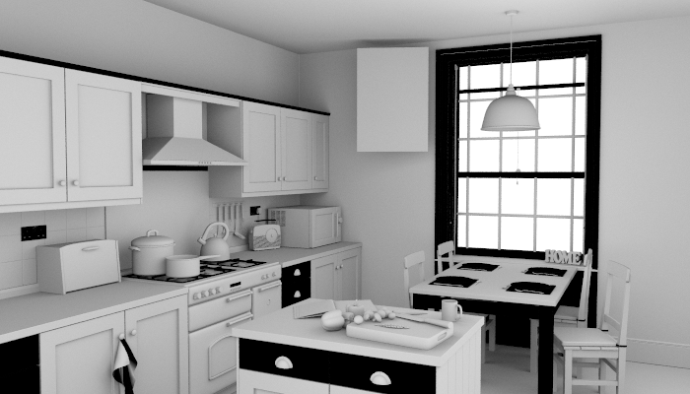
Path Guiding Pipeline
N times
$L\left(x,ω_{i}\right)$
Incident
$$x$$
Load Scene
Precompute
Guiding Distribution
Render Image
Takes minutes / hours!
Notes:
First, we load a scene. Then, we precompute an approximate version of L with path tracing.
As I have mentioned before, iterating this precomputation pays off significantly. Essentially, we precompute a sequence of guiding distributions, where each computation is guided by the result of the previous one.
So, once we are done iterating on the guiding distribution we will actually render the image, guided by the result of the final iteration of this precomputation.
Now, there is one big issue with this pipeline. The precomputation can take minutes to hours, and it needs to happen before you can see a preview of what the rendered image is going to look like! If you are an artist and you made a change to the scene, you don’t want to wait minutes to hours until you can see what kind of effect it has.

Slide 19
Path Guiding Pipeline
N times
$L\left(x,ω_{i}\right)$
Incident
+
$$x$$
Load Scene
Precompute
Guiding Distribution
Render Image
Notes:
The way we propose to avoid this problem is to combine this precomputation and rendering of the image into the same step and iterating on that.

Slide 20
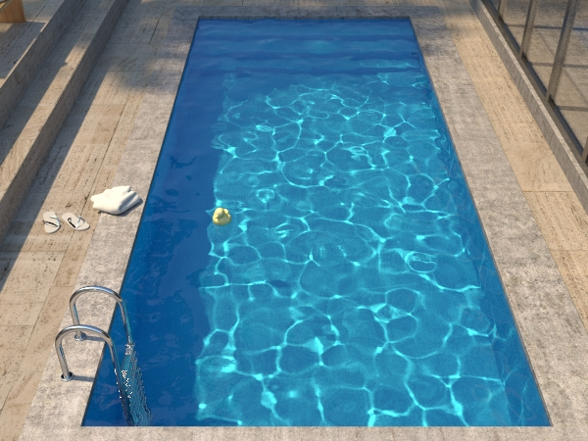
Iterated Path Guiding
Scene courtesy of Ondřej Karlík
Notes:
Let me demonstrate how that works by showing you an example run. Here our goal is to render a nice picture of this swimming-pool, where the caustics on the floor of the pool are particularly difficult to render for path tracers.

Slide 21
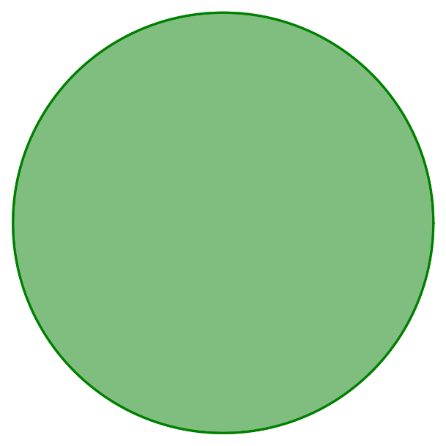


Iterated Path Guiding
Guiding Distribution:
Initialization:
$L\left(x,ω_{i}\right)$
Incident
$$x$$
Notes:
We start by initializing our method with a uniform guiding distribution---all directions are equally likely---and a black image.
We then render a low sample count image and as we trace paths through the scene, we also use them to precompute a new and slightly better guiding distribution.

Slide 22
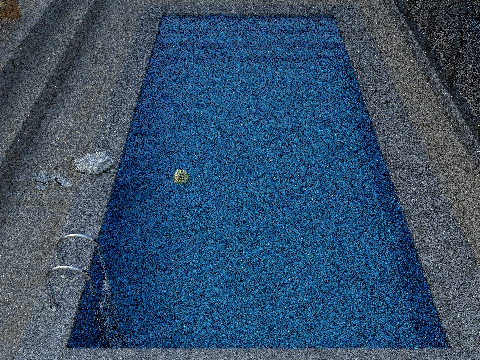



Iterated Path Guiding
Iteration 1:
4 Samples Per Pixel
Guiding Distribution:
$L\left(x,ω_{i}\right)$
Incident
$$x$$
$L\left(x,ω_{i}\right)$
Incident
$$x$$
Notes:
That was the first iteration of our algorithm.

Slide 23


Iterated Path Guiding
Iteration 1:
4 Samples Per Pixel
Guiding Distribution:
$L\left(x,ω_{i}\right)$
Incident
$$x$$
Notes:
We now take this new guiding distribution, throw away the existing image, and render a new one at twice the sample count.

Slide 24
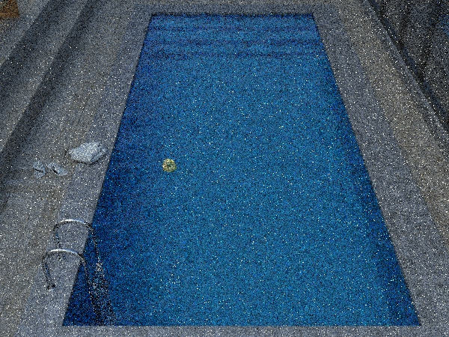


Iterated Path Guiding
Iteration 2:
8 Samples Per Pixel
Guiding Distribution:
$L\left(x,ω_{i}\right)$
Incident
$$x$$
$L\left(x,ω_{i}\right)$
Incident
$$x$$
Notes:
Again, as we trace paths to compute this image, we use them to rebuild an even better guiding distribution.
You can see that the guiding distribution now has this large peak. Maybe it figured out where the sun is?

Slide 25


Iterated Path Guiding
Iteration 2:
8 Samples Per Pixel
Guiding Distribution:
$L\left(x,ω_{i}\right)$
Incident
$$x$$
Notes:
Let’s find out. We again throw away the previous image and render a new one with twice the sample count.

Slide 26
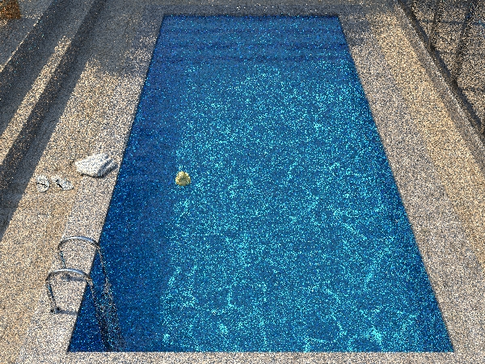



Iterated Path Guiding
Iteration 3:
16 Samples Per Pixel
Guiding Distribution:
$L\left(x,ω_{i}\right)$
Incident
$$x$$
$L\left(x,ω_{i}\right)$
Incident
$$x$$
Notes:
Now the generated image starts to look a lot better than before. It seems like the guiding distribution indeed found the direction of the sun.
Let’s perform one more iteration.

Slide 27


Iterated Path Guiding
Iteration 3:
16 Samples Per Pixel
Guiding Distribution:
$L\left(x,ω_{i}\right)$
Incident
$$x$$

Slide 28
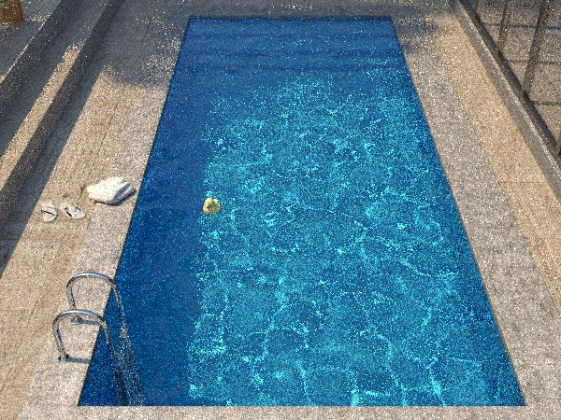
Iterated Path Guiding
Iteration 4:
32 Samples Per Pixel
Guiding Distribution:
$L\left(x,ω_{i}\right)$
Incident
$$x$$
$L\left(x,ω_{i}\right)$
Incident
$$x$$
Notes:
So now that you’ve seen how our iterative approach works, I’d like to also show you how we adapt our directional quadtrees to the incident radiance.

Slide 29
Storing the Guiding Distribution
Directional Quadtree
$L\left(x,ω_{i}\right)$
Incident
$$x$$
Notes:
So now that you’ve seen how our iterative approach works, I’d like to also show you how we adapt our directional quadtrees to the incident radiance.

Slide 30
Directional Quadtree Subdivision
Iteration 1 Refinement
: Subdivide until energy <10%
25%
25%
100%
25%
25%
Notes:
In the first iteration we start with a uniform distribution. This means that our quadtree simply has a single node that contains 100% of the total energy. Our subdivision heuristic is simply: Subdivide nodes until their energy is below some percentage. For this example we use 10%.
So this node clearly has more than 10% energy, so we subdivide it. The resulting nodes still have over 10% energy, so we subdivide them again. Simple.

Slide 31
Directional Quadtree Subdivision
Iteration 1 Refinement: Subdivide until energy <10%
6.25%
6.25%
6.25%
6.25%
6.25%
6.25%
6.25%
6.25%
100%
6.25%
6.25%
6.25%
6.25%
6.25%
6.25%
6.25%
6.25%

Slide 32
Directional Quadtree Subdivision
Iteration 1 Path Tracing
6.25%
6.25%
6.25%
6.25%
12%
7%
6%
2%
6.25%
6.25%
6.25%
6.25%
8%
4%
20%
2%
6.25%
6.25%
6.25%
6.25%
2%
3%
16%
5%
6.25%
6.25%
6.25%
6.25%
1%
1%
5%
6%
Notes:
Now, after we have subdivided, we will be performing our simultaneous rendering and training step where we simply populate this quadtree with new, more accurate entries with path tracing.

Slide 33
Directional Quadtree Subdivision
Iteration 2 Refinement: Subdivide until energy <10%
3%
3%
12%
7%
6%
2%
7%
6%
2%
3%
3%
5%
5%
8%
4%
20%
2%
8%
4%
2%
5%
5%
4%
4%
2%
3%
16%
5%
5%
7%
4%
4%
1%
1%
5%
6%
5%
6%
Notes:
Now we are at the start of our second iteration. Here we simply take these updated values and apply our subdivision criterion again.
These nodes have more than 10% energy, so they need to be subdivided.
And these 4 nodes can be merged back together while remaining below 10%, so let’s do just that.
And that’s it. This simple subdivision criterion results in an equi-energy partitioning of our distribution, which means that high-contribution regions receive a high resolution as desired.
With this scheme, the number of nodes is bounded, because there can only be so many nodes with roughly equal energy until they add up to 100%. By adjusting the subdivision threshold we can therefore control the memory usage.
For all our results we set the subdivision threshold to 1%, which always kept the total memory footprint under 20 megabytes.

Slide 34
Iterated Path Guiding
Iteration 4:
32 Samples Per Pixel
Guiding Distribution:
$L\left(x,ω_{i}\right)$
Incident
$$x$$
$L\left(x,ω_{i}\right)$
Incident
$$x$$
Notes:
Going back to our pool example, let’s gauge the usefulness of our iterated scheme by comparing against the baseline path tracer which we guide here.

Slide 35
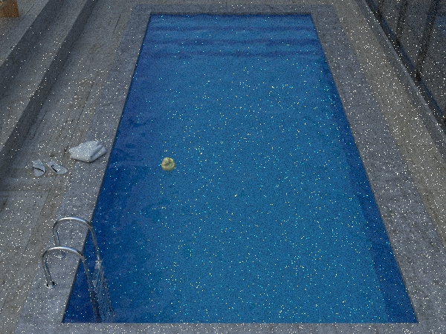
Iterated Path Guiding
Path Tracing:
64 Samples Per Pixel
Iteration 4:
32 Samples Per Pixel
2.4 seconds
3.5 seconds
Notes:
We gave the path tracer twice as many samples as our image to make up for the samples we used for training in the previous iterations. To make the point clearer, let’s give the path tracer 10 times more samples than that.

Slide 36
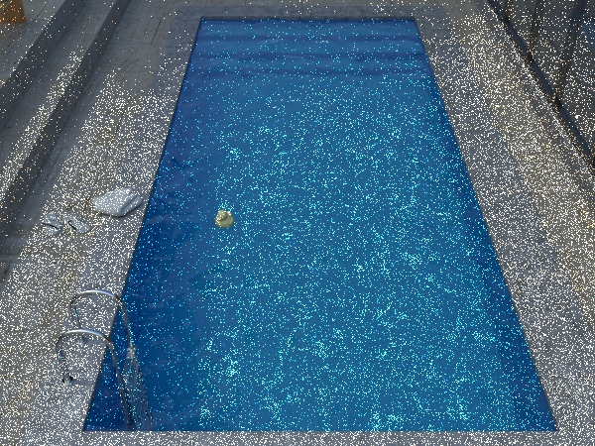
Iterated Path Guiding
Path Tracing:
640 Samples Per Pixel
Iteration 4:
32 Samples Per Pixel
24 seconds
3.5 seconds
Notes:
Even then the path tracer’s image is much worse than ours, which nicely illustrates the effectiveness of the iterated scheme.

Slide 37
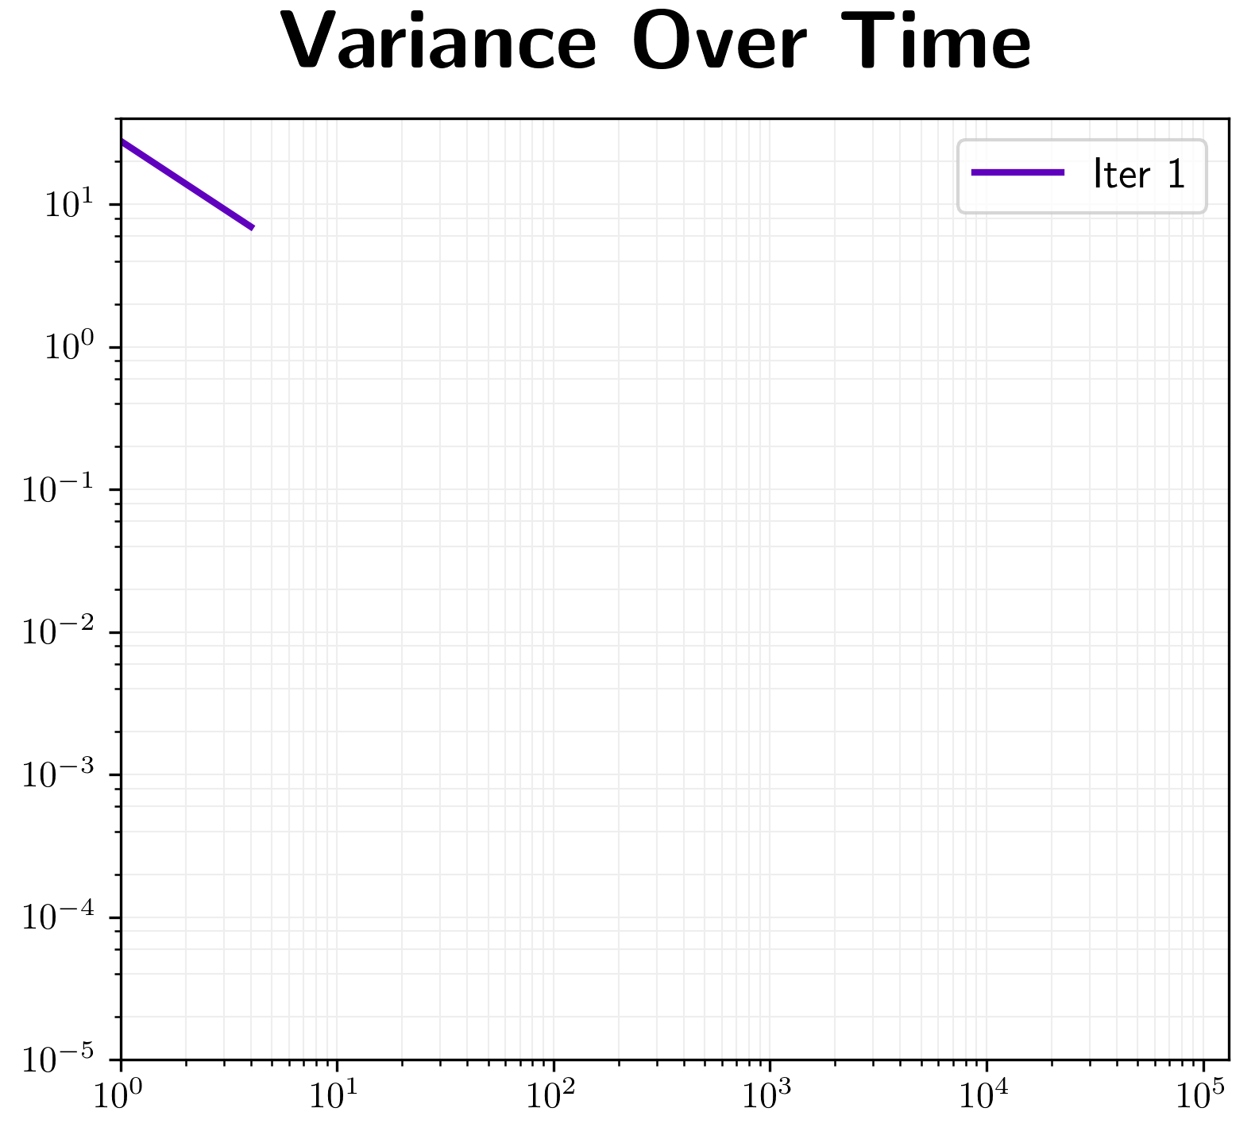
When to Stop Iterating?
Time (seconds)
Notes:
Let’s have a look at the convergence behavior of our iterative approach. Here I am showing a plot of variance over time, depicting only the first iteration of our algorithm.
After each iteration there is a choice: Either we begin the next iteration, which would look like this.

Slide 38
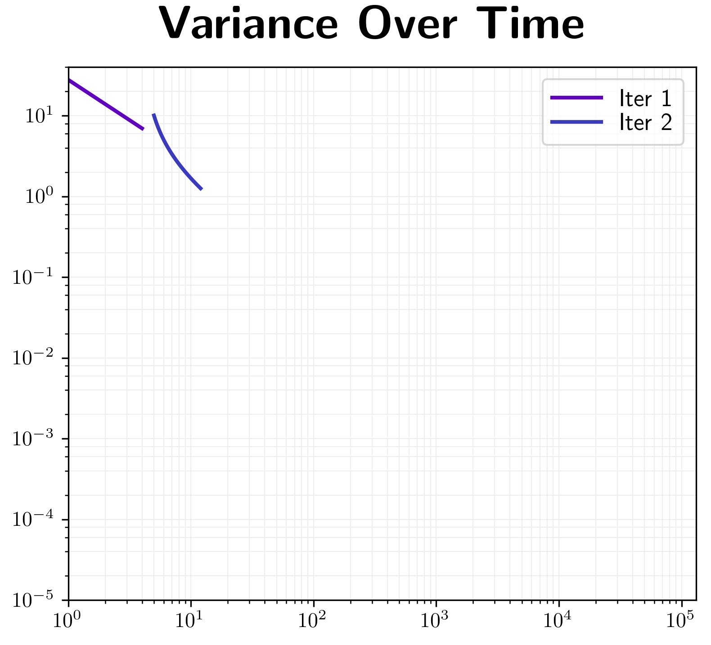
When to Stop Iterating?
Time (seconds)
Notes:
Or, after any iteration we can just continue rendering with the current guiding distribution.

Slide 39
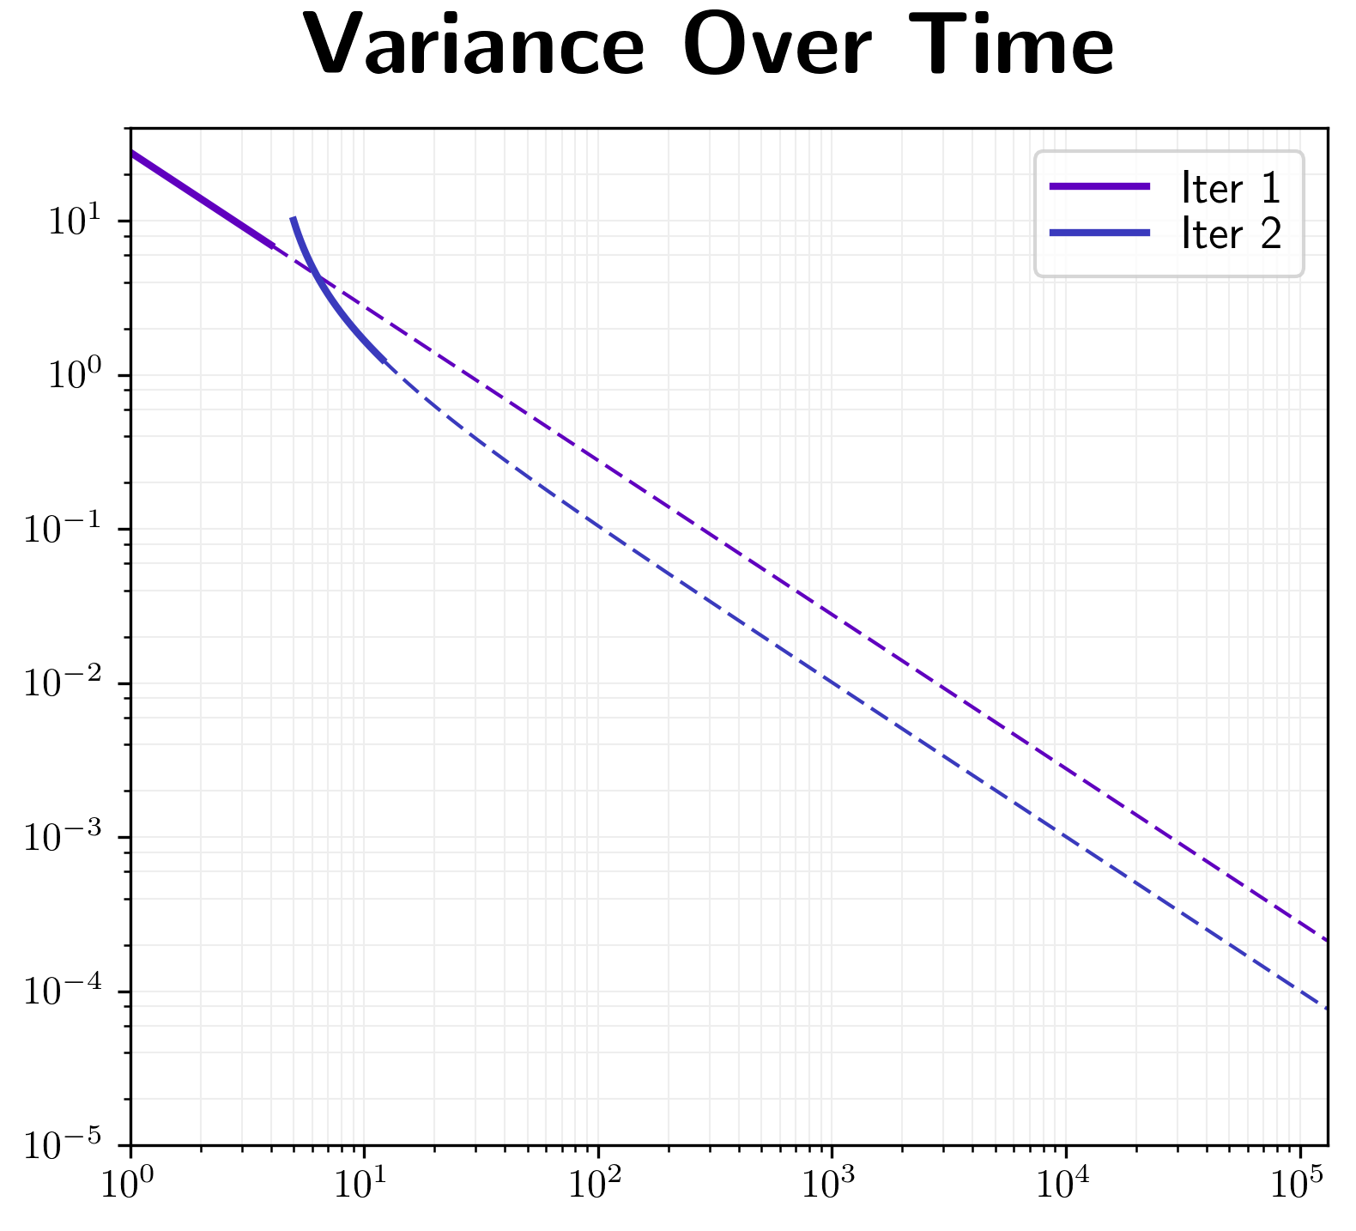
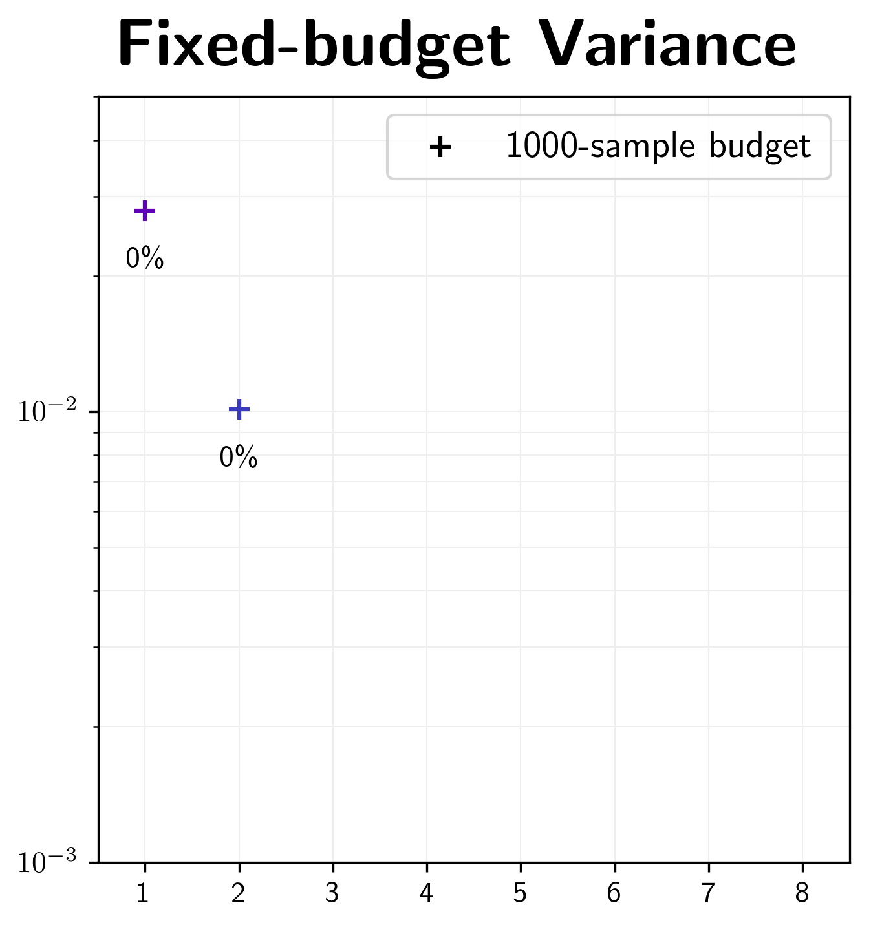
When to Stop Iterating?
1000 spp
Time (seconds)
Iteration #
Notes:
Because of the predictable convergence of Monte Carlo algorithms, we can easily extrapolate the variance curves for each iteration as indicated by the dashed extensions. We can see here, that the second iteration starts out worse than the previous one because we threw away the previous image, but then quickly catches up due to its better guiding distribution.
Now, if we have a fixed render budget, for instance 1000 samples per pixel, we can indicate that as a vertical line.
The intersections of our extrapolated dashed lines and this vertical line tell us the variance we would achieve if we kept rendering rather than starting new iterations.
Let’s add the curves corresponding to more iterations.

Slide 40
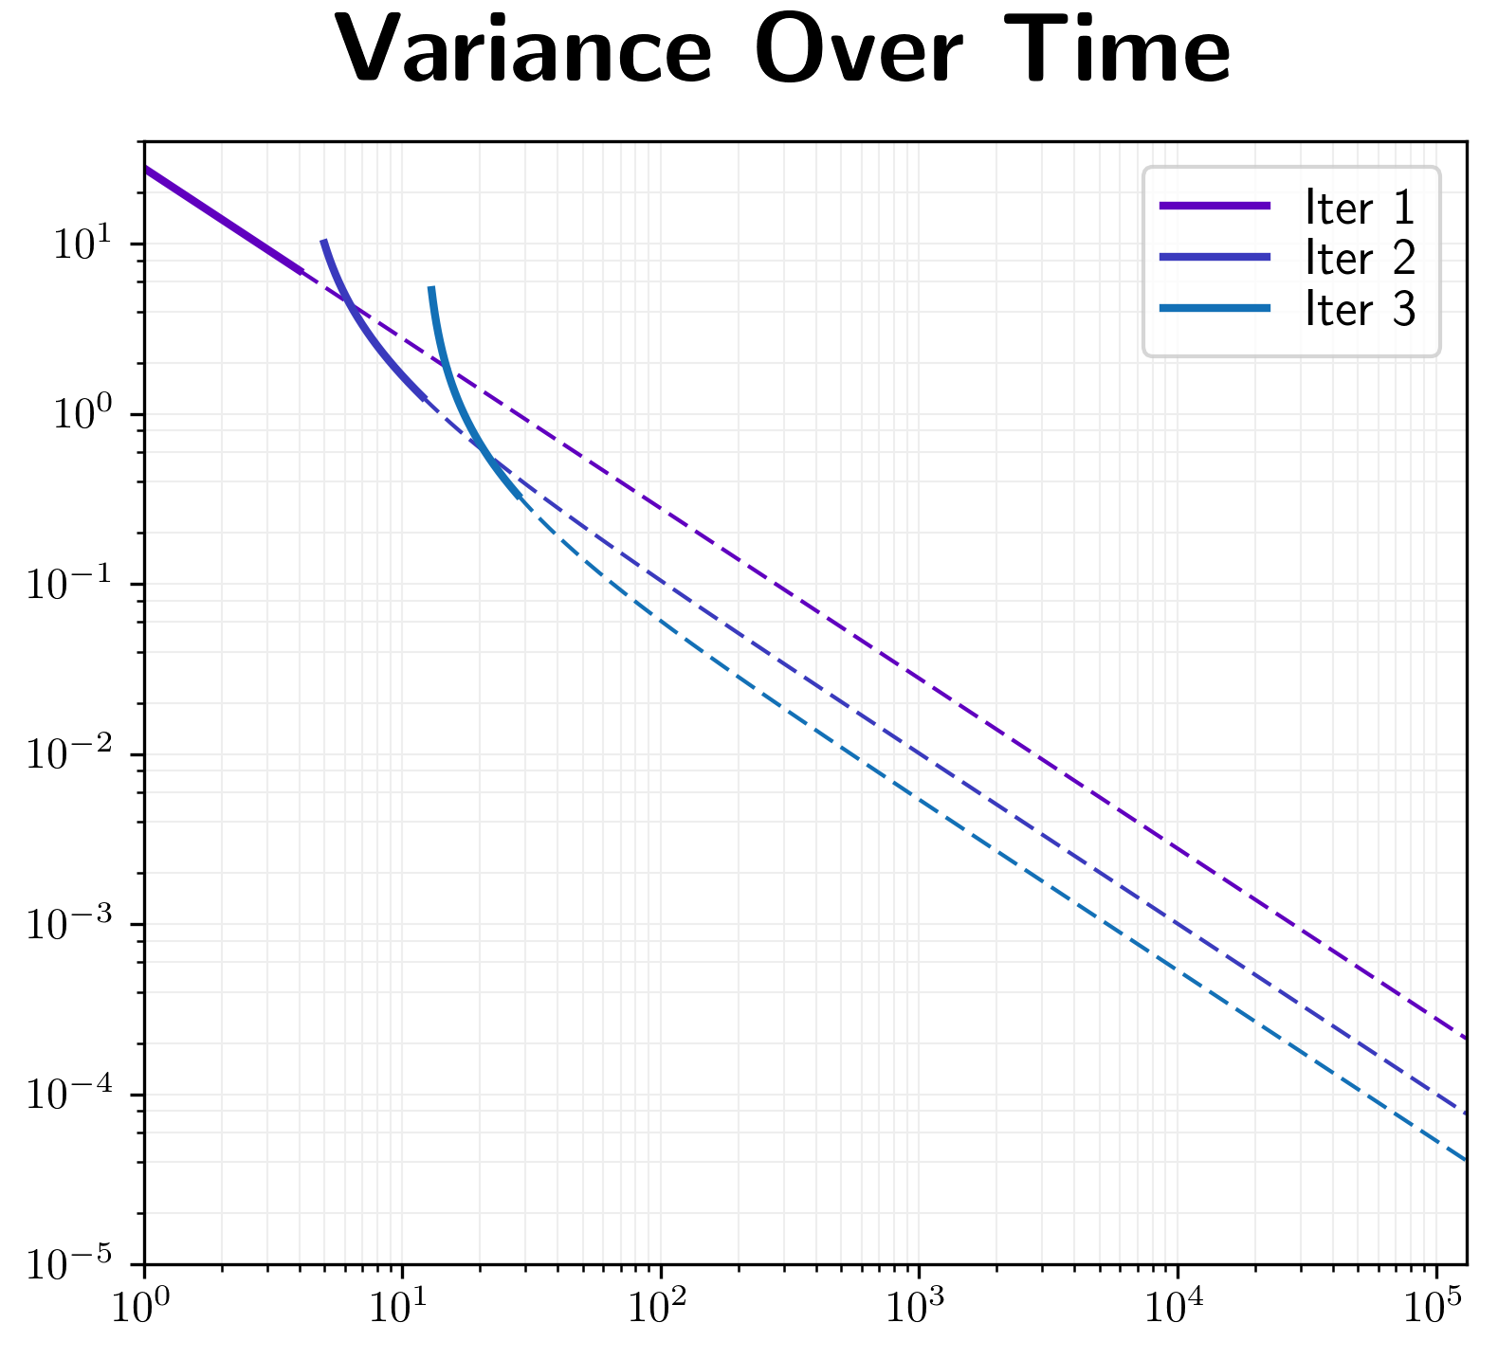
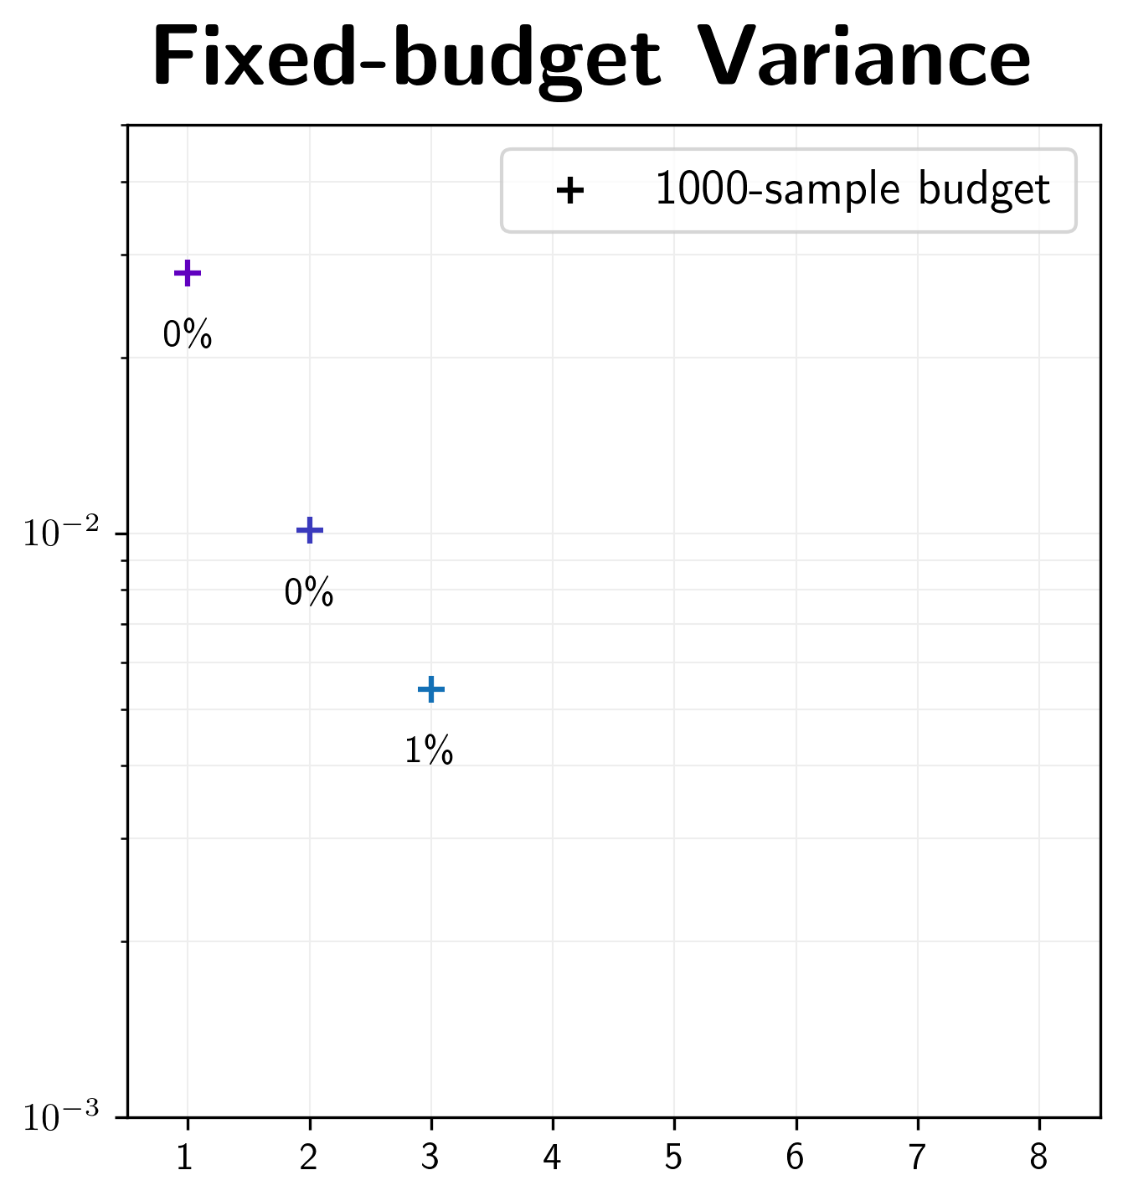
When to Stop Iterating?
1000 spp
Time (seconds)
Iteration #

Slide 41
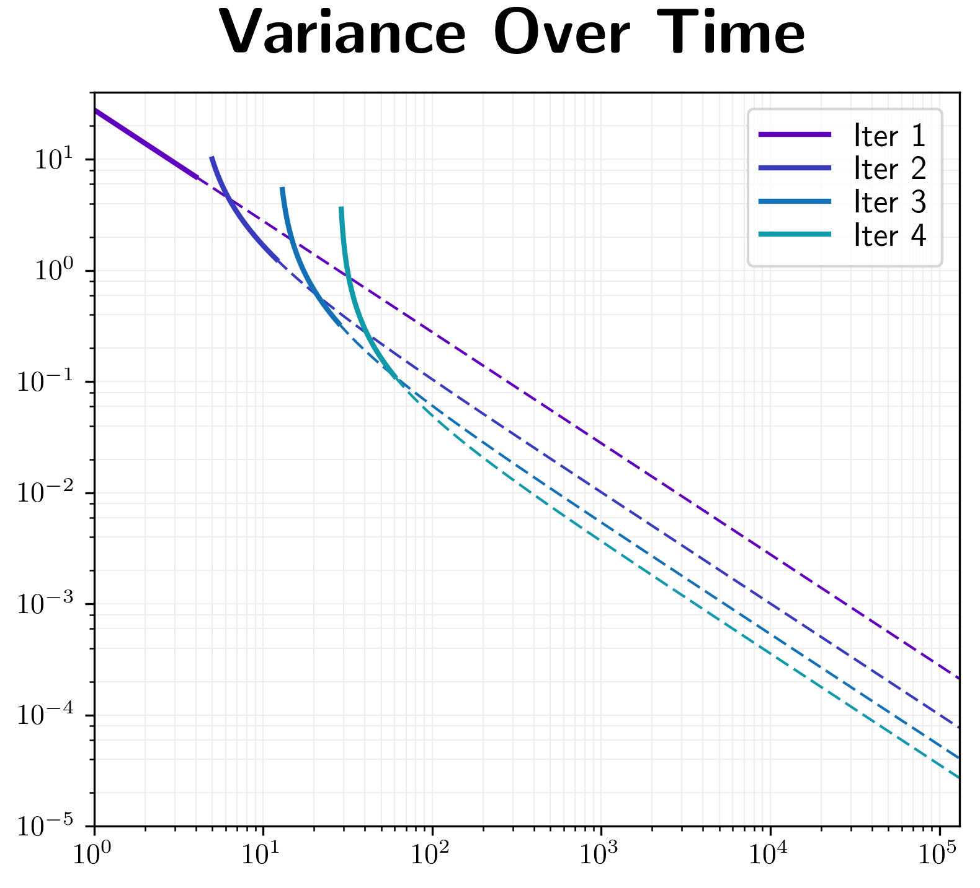
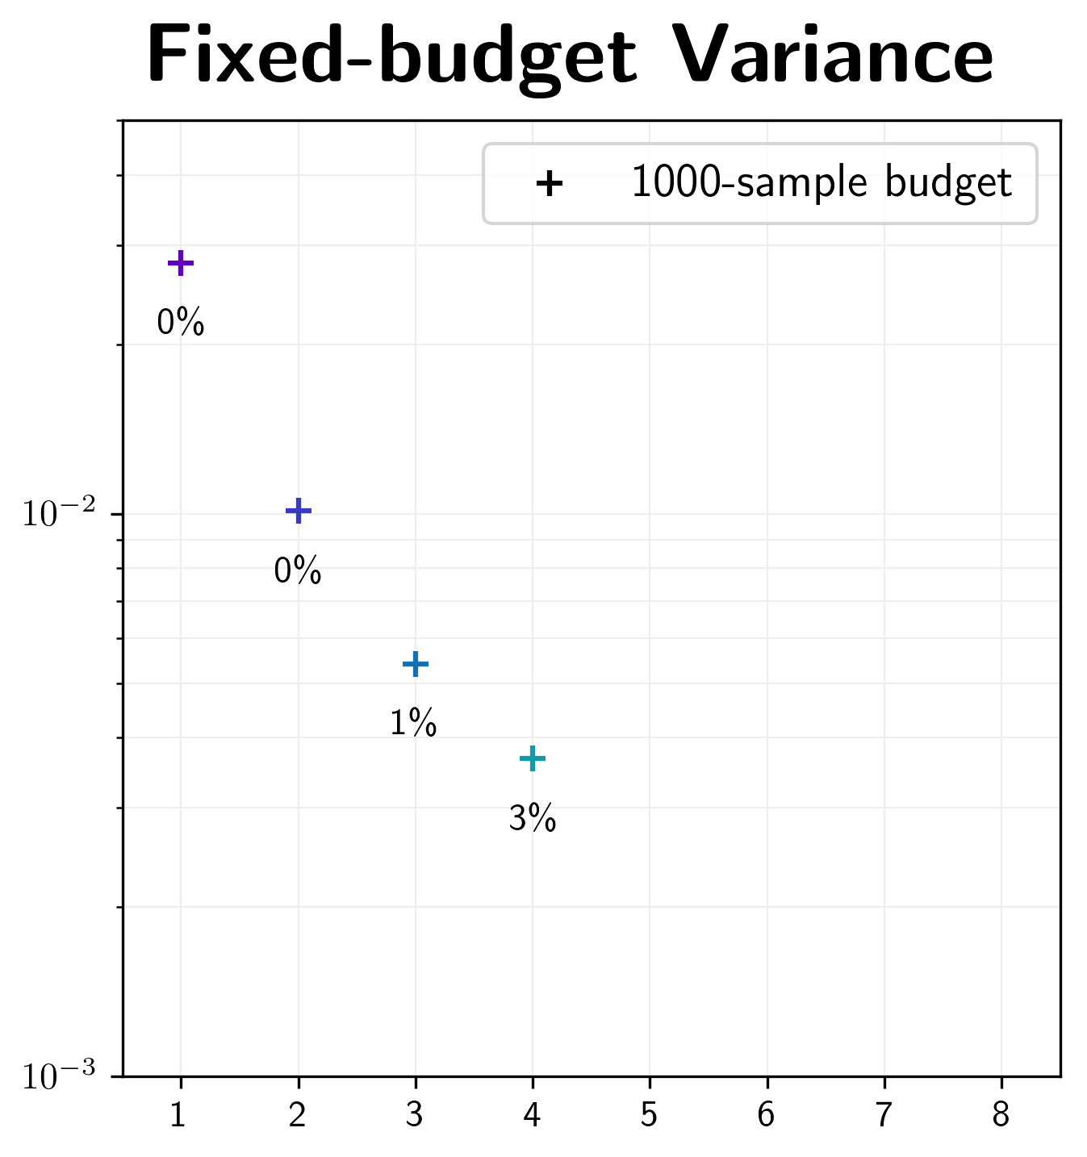
When to Stop Iterating?
1000 spp
Time (seconds)
Iteration #

Slide 42
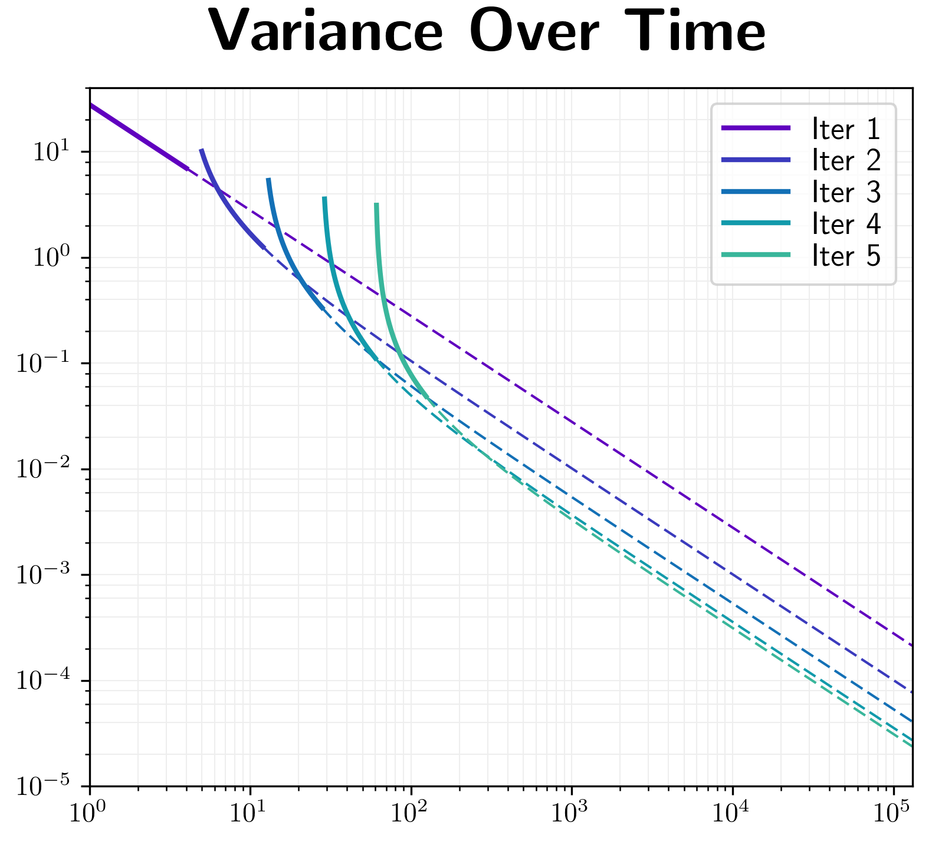
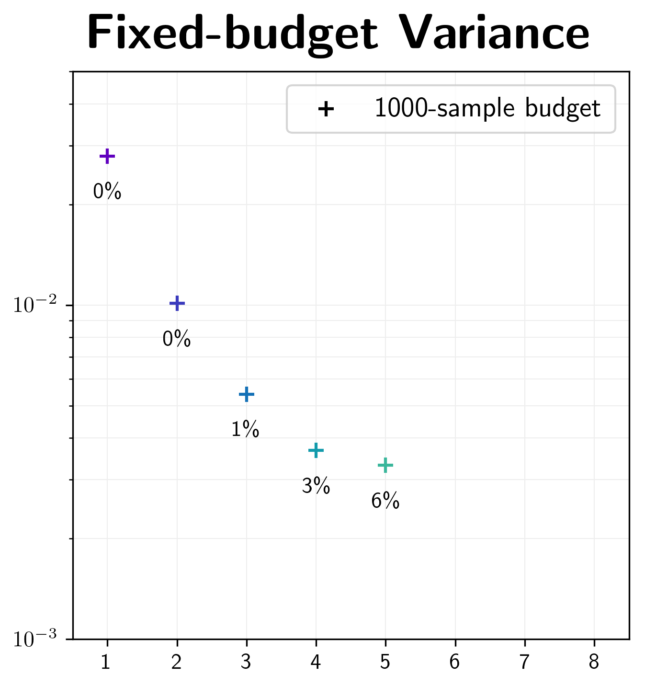
When to Stop Iterating?
1000 spp
Time (seconds)
Iteration #

Slide 43
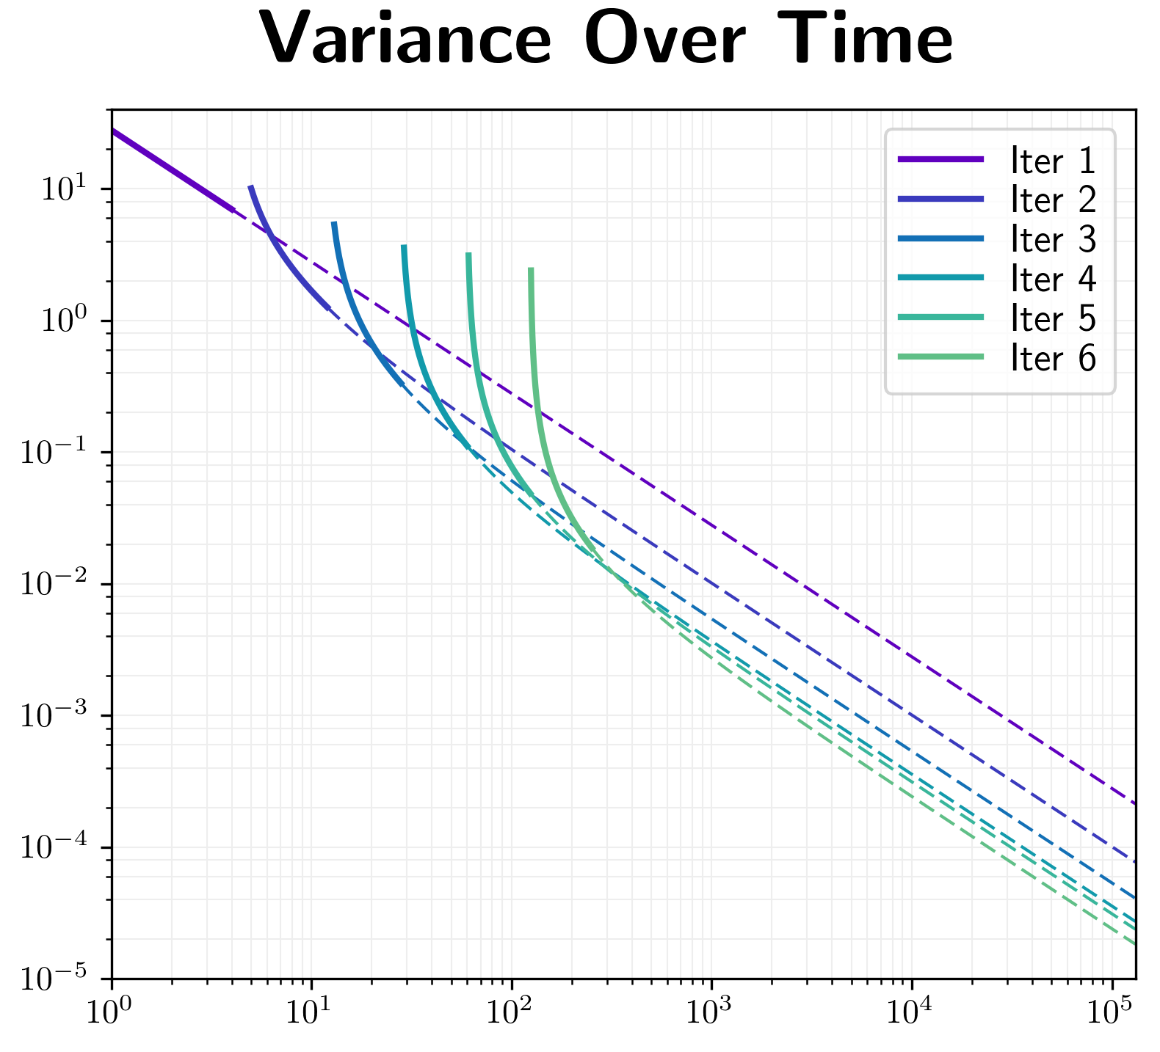
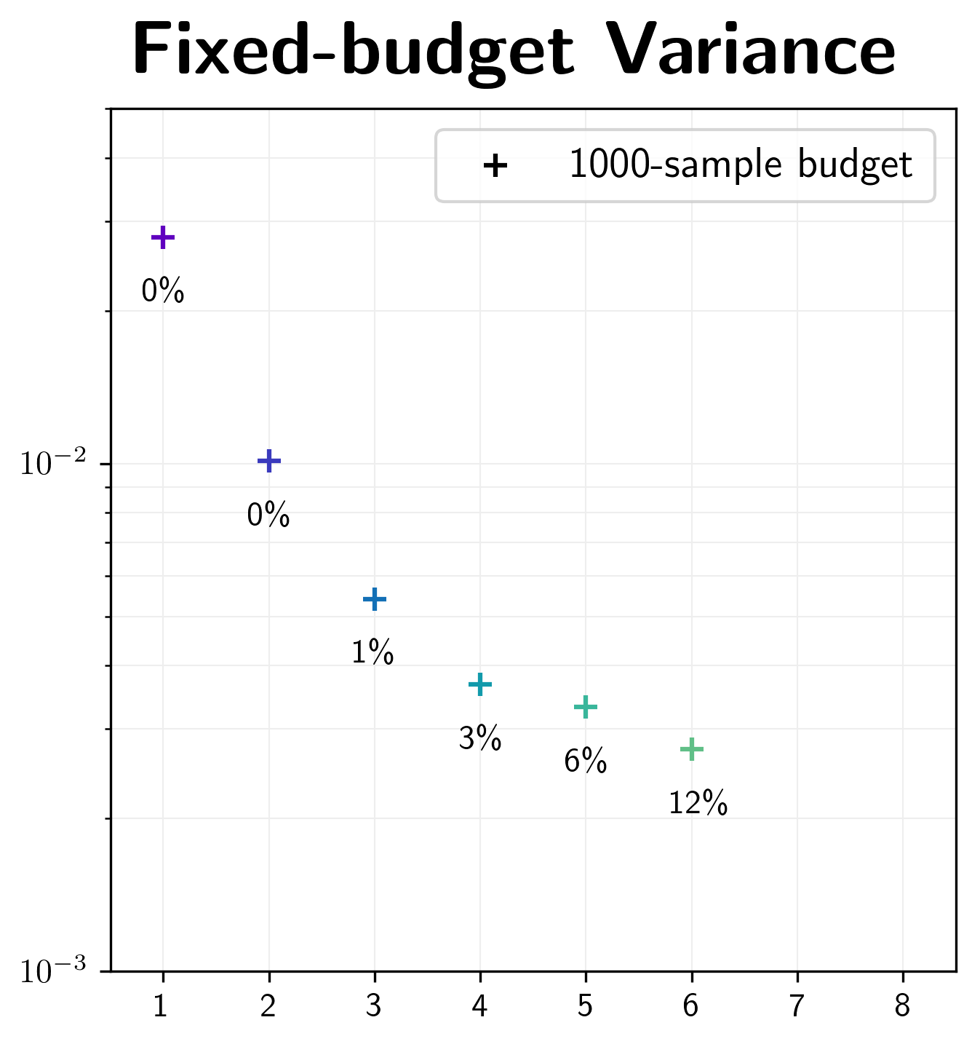
When to Stop Iterating?
1000 spp
Time (seconds)
Iteration #

Slide 44
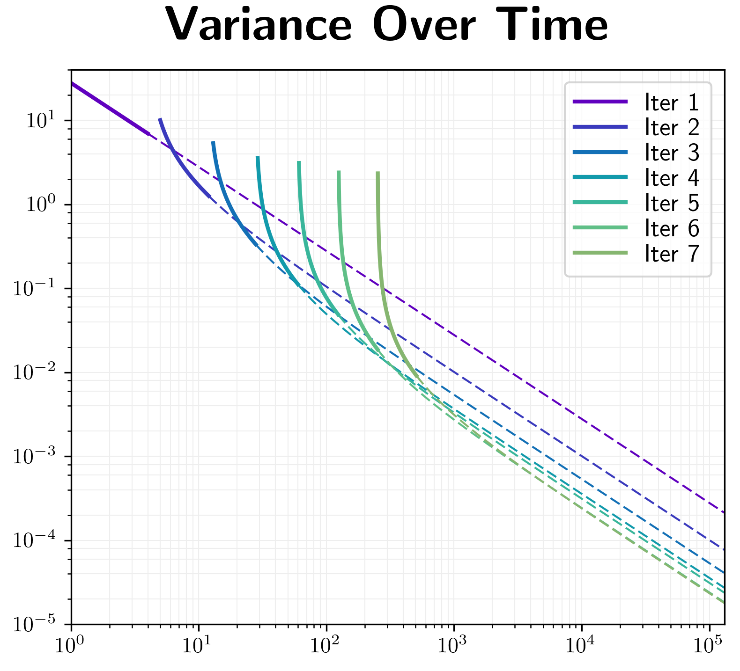
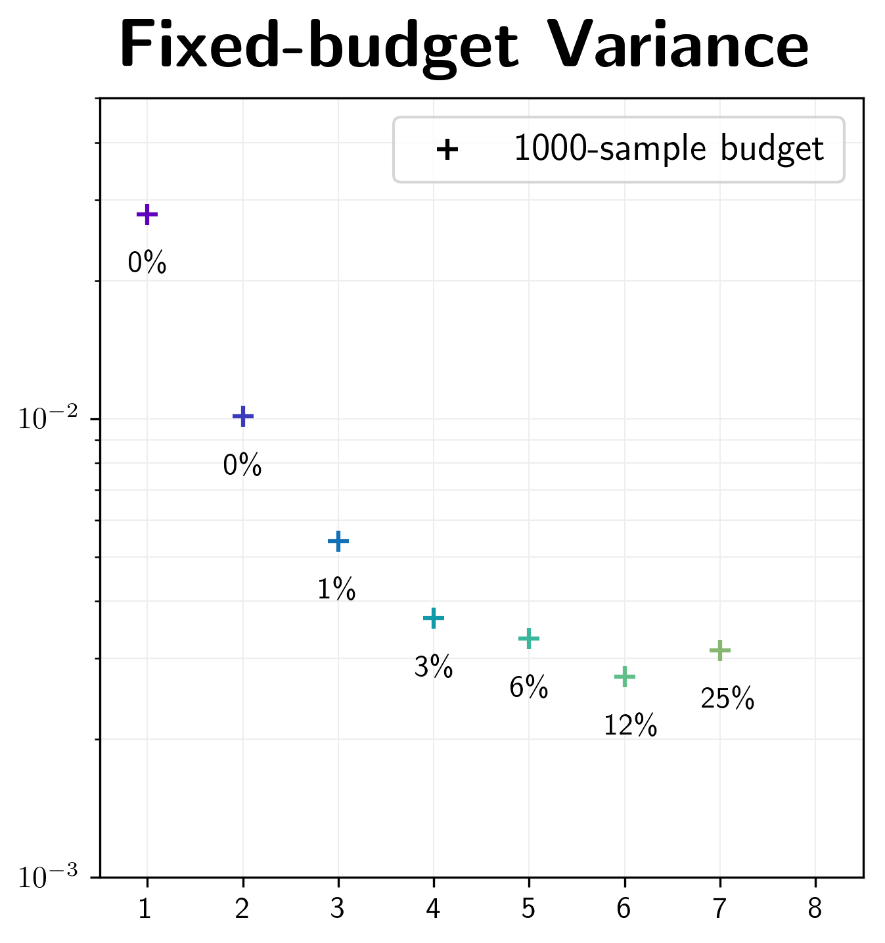
When to Stop Iterating?
1000 spp
Time (seconds)
Iteration #

Slide 45
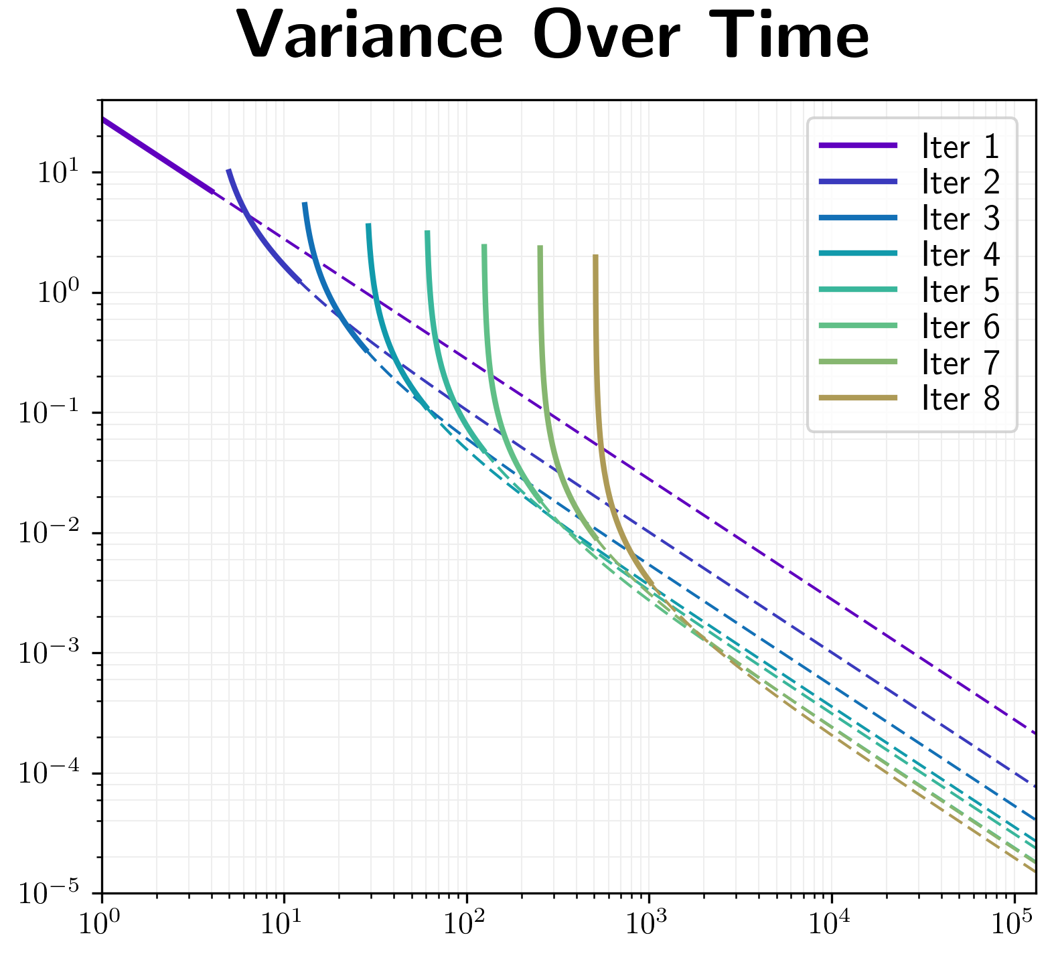
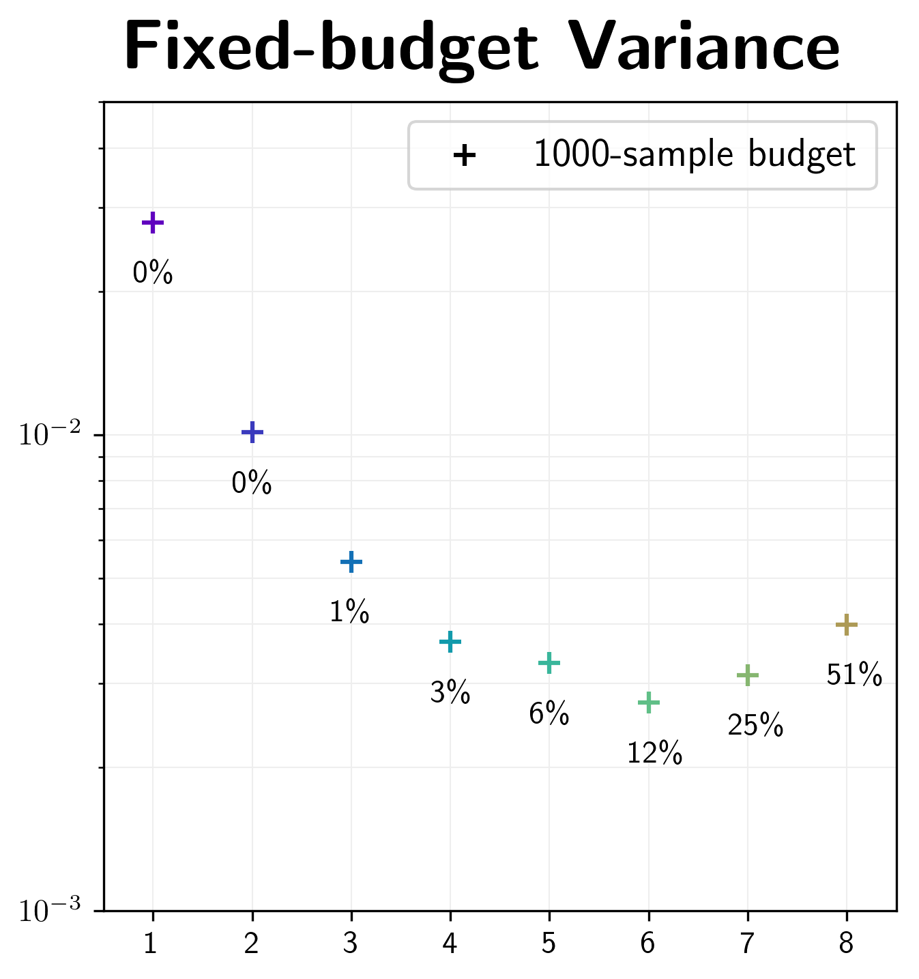
When to Stop Iterating?
1000 spp
Time (seconds)
Iteration #

Slide 46
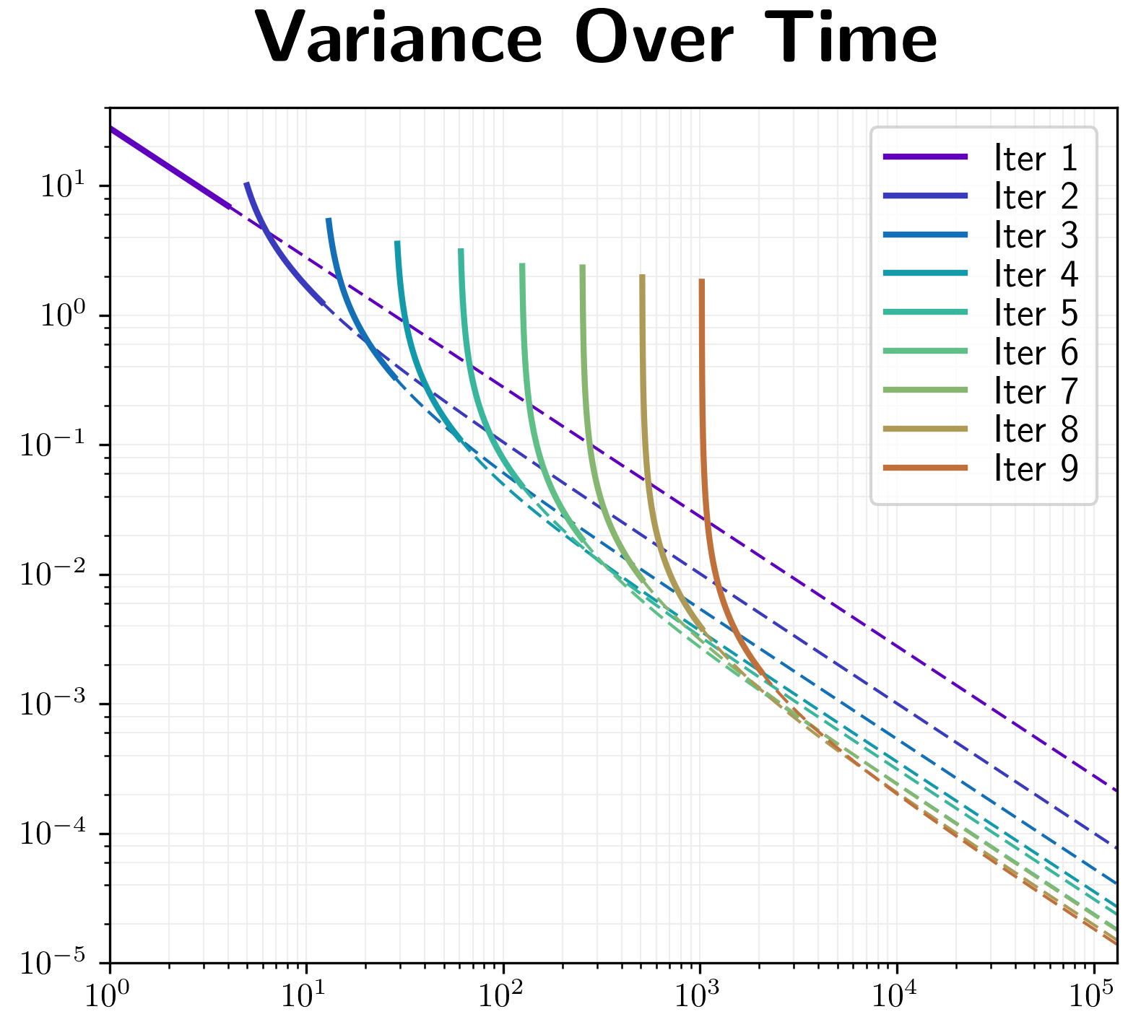
When to Stop Iterating?
1000 spp
Time (seconds)
Iteration #

Slide 47
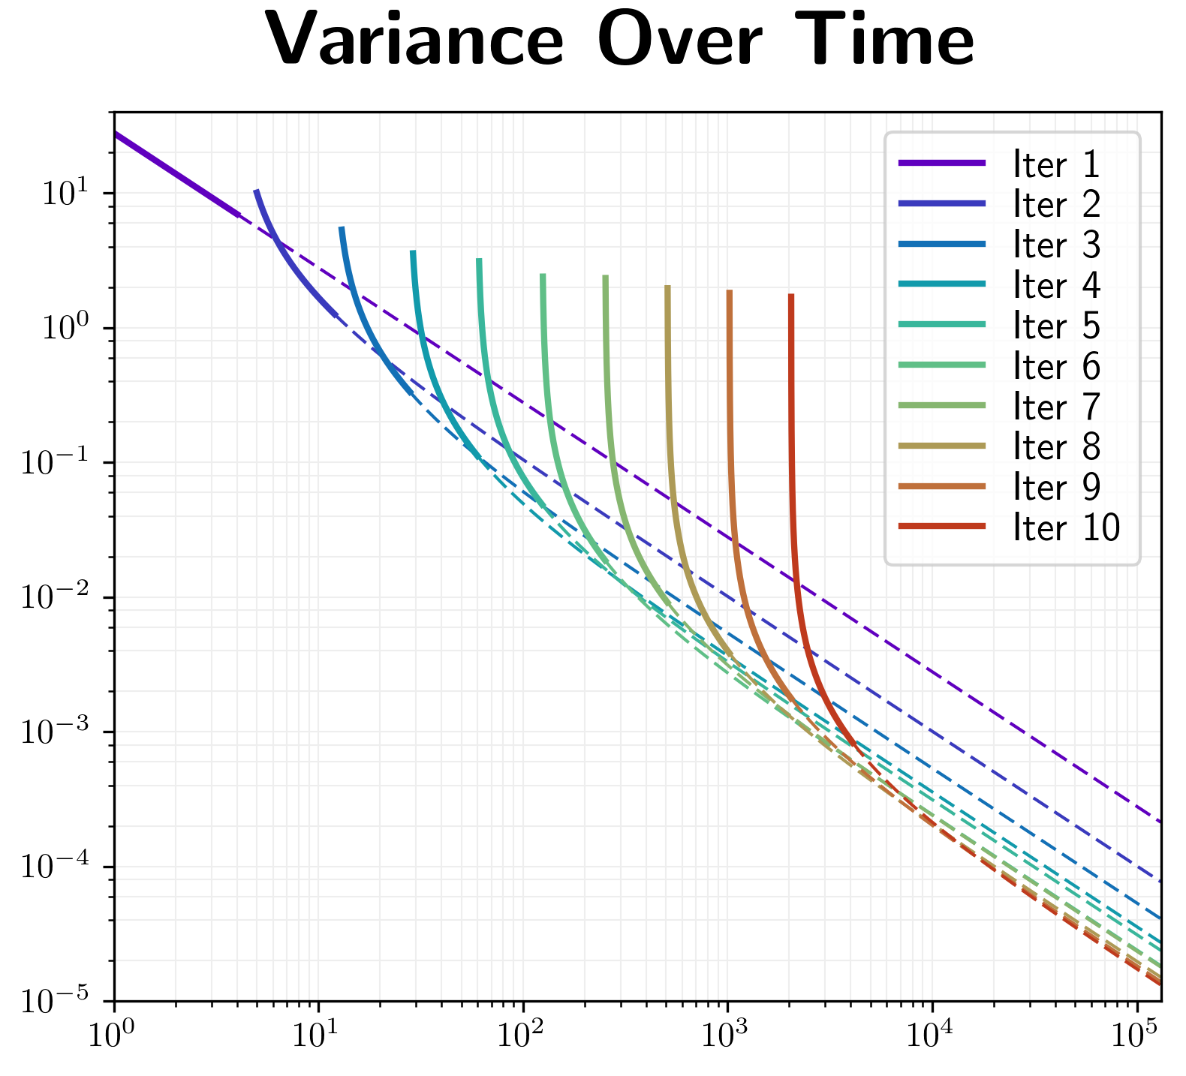
When to Stop Iterating?
1000 spp
Time (seconds)
Iteration #

Slide 48
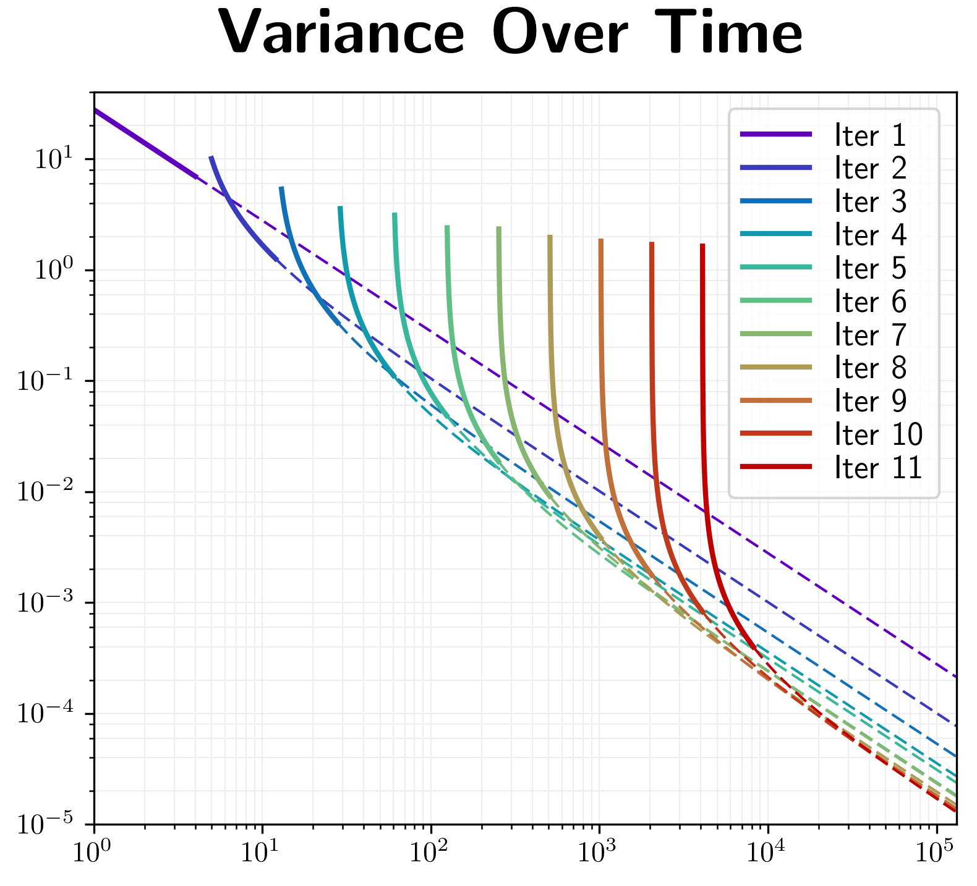
When to Stop Iterating?
1000 spp
Time (seconds)
Iteration #
Notes:
Alright, there we go. Since our goal is to minimize variance, let’s look up the minimum point of our sequence of intersections on the right, here. In this case, it would be optimal to simply keep rendering at the end of the 6th iteration, rather than starting over with the 7th iteration. This amounts to using 12% of our total budget for training the guiding distribution, and the remaining 88% for rendering.
In the paper we show how to automatically find this sweet-spot during rendering.

Slide 49
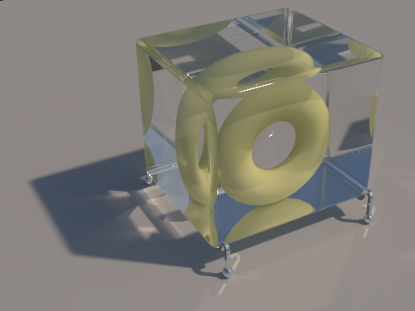

Results
Disney Confidential - Do Not Distribute
Notes:
Let me show you some results in scenes with complicated light transport.

Slide 50
Torus
Scene courtesy of Olesya Jakob, based on a Scene by Cline et al.
Notes:
This conveniently placed torus in a glass cube leads to Specular-Diffuse-Specular light paths which are notiously difficult to simulate for path tracing algorithms.

Slide 51
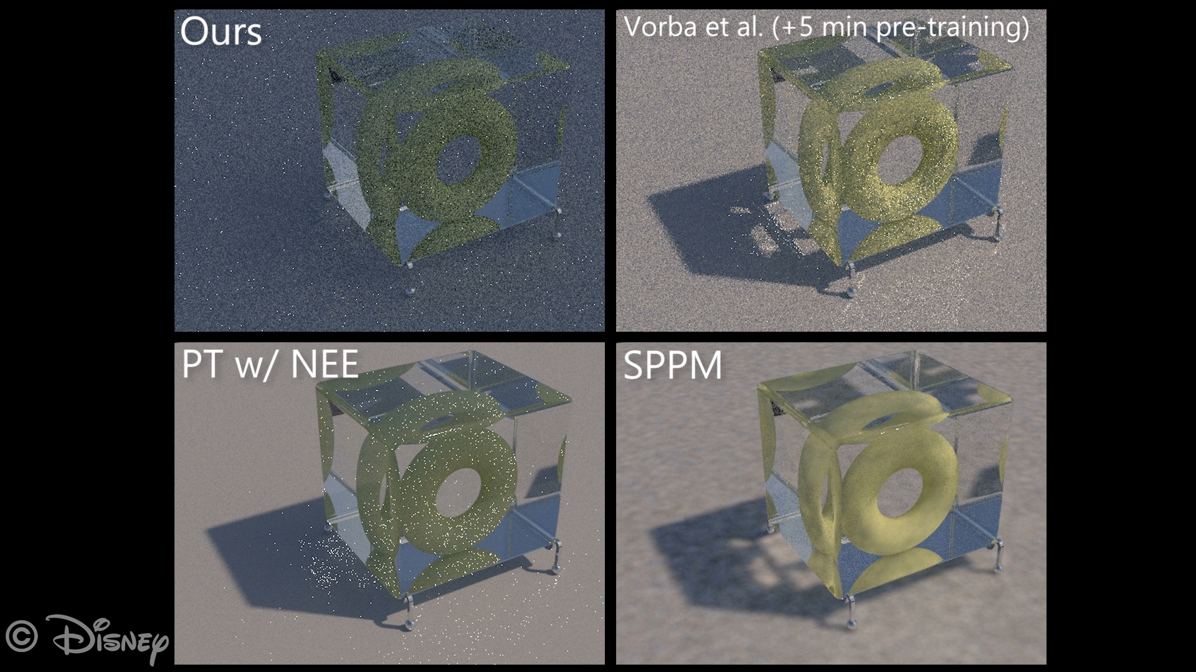
Pool: Ours vs. Manifold Exploration MLT
Notes:
Here I am going to show you equal-time progressive renderings of different methods. In the top-left corner we have our algorithm, which starts out with a really bad estimate because we base it on a naïve path tracer with just BSDF sampling. We do this demonstrate that our algorithm can compete with more advanced techniques on its own.
In the top-right corner we compare against the state-of-the-art in path guiding by Vorba et al., which unlike our method we pre-trained for 5 minutes.
We used the authors’ publicly available implementation. Unfortunately, just last Friday, Sebastian Herholz found an issue with this public implementation of Vorba’s method, which negatively affects its performance. With this issue fixed, both their and our method would have a similar computational overhead, so please take the following speed comparisons with a grain of salt. However, our other improvements such as our robustness remain in any case.
But now back to the actual comparison.
In the bottom left corner we have path tracing with next event estimation, and in the bottom right we have stochastic progressive photon mapping.
I’ll start the rendering now.
As you can see, our algorithm quickly learns the correct guiding distribution, surpassing Path Tracing and Vorba’s method. Photon mapping gives a smoother, noise-free solution very quickly, but unfortunately is biased, manifesting as blurry caustics.

Slide 52
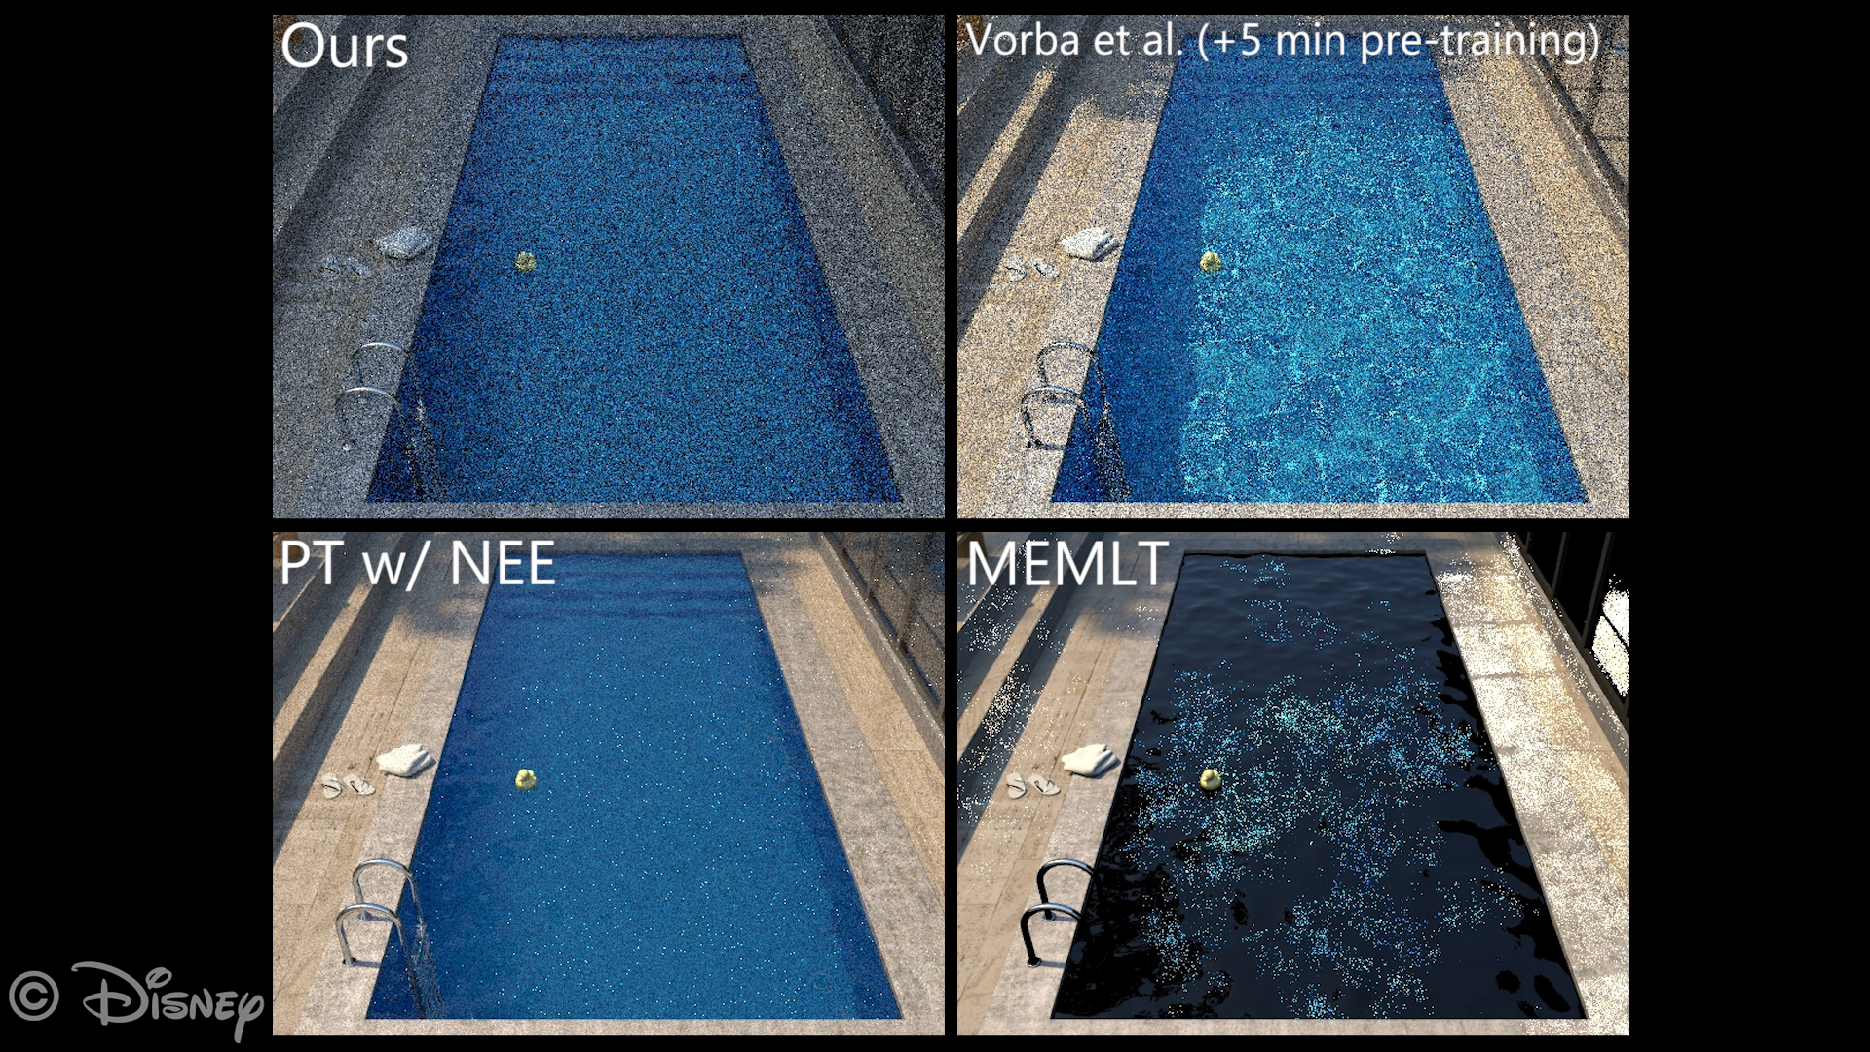
Pool: Ours vs. Manifold Exploration MLT
Notes:
Here we are looking at the pool scene from before. We compare the same methods, except that in the bottom right we replaced photon mapping with manifold-exploration MLT just to compare against another advanced technique.
I’ll start the rendering now.
In this scene our method again quickly surpasses path tracing and catches up to Vorba’s method. Manifold Exploration does really well, but unfortunately converges unevenly, as is common for Markov-Chain Monte Carlo techniques. In this case it gets stuck in a small region of path space, resulting in a way too bright window frame here, and darkening in the rest of the image.

Slide 53
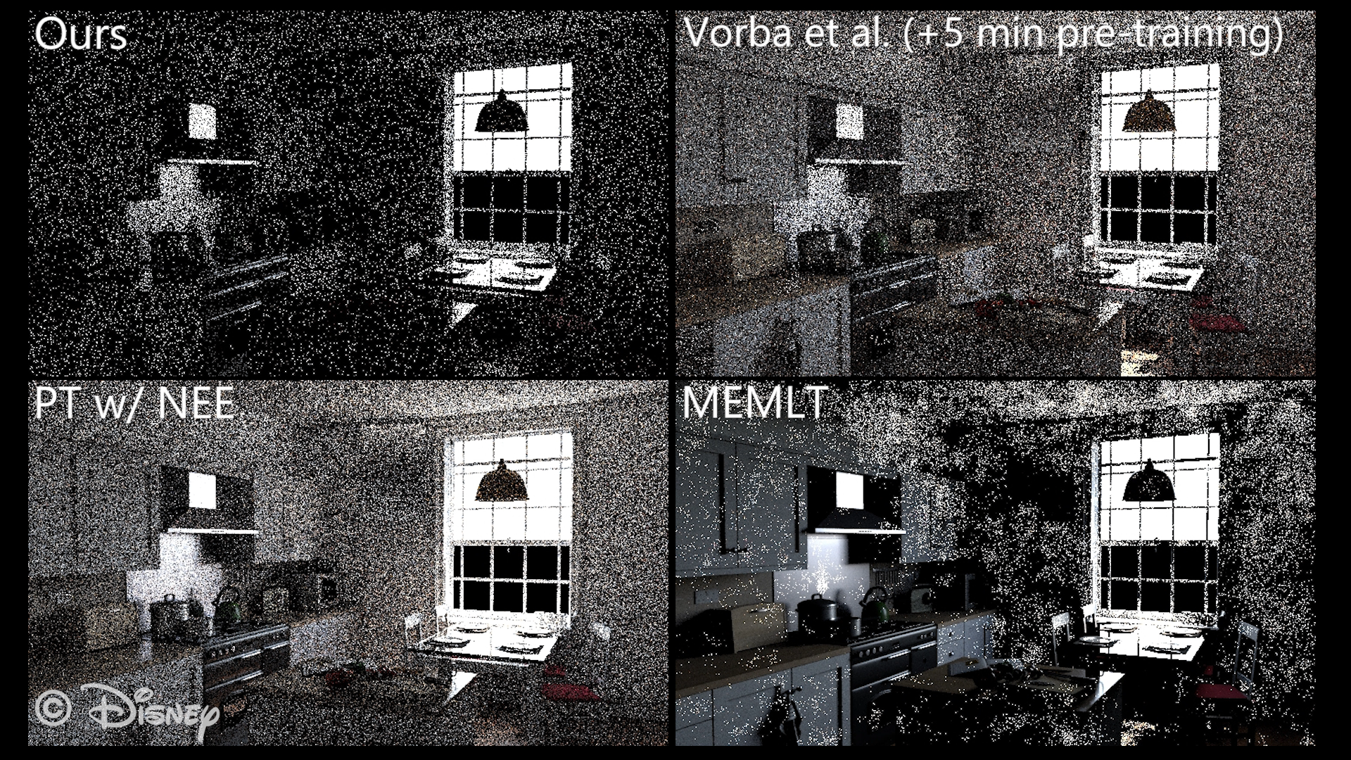
Pool: Ours vs. Manifold Exploration MLT
Notes:
Lastly I’d like to show the Kitchen scene.
The rendering starts now.
In this scene our method quickly surpasses path tracing and Vorba’s path guiding technique. Manifold Exploration, however, does an excellent job at converging to a good solution quickly. Unfortunately, there are still issues with uneven convergence. For instance the caustic in the mirror, here, is slightly darker, which may cause flickering when rendering animations.

Slide 54
Limitations & Future Work
Guiding distribution is only approximate
MIS with other sampling technique is essential
              Sampling from BSDF x Guiding Distribution would be ideal
              Spherical Harmonics x Haar Wavelets [Jarosz et al. 2009]
              Importance Resampling [Talbot et al. 2005]
            Motion Blur
            Add time dimension to spatial data structure
Notes:
Next, I’d like to highlight the I believe most important limitations and avenues for future work.
First of all, these precomputed guiding distributions are only approximate. This becomes most problematic when considering tiny emitters at a small distance, and delta light sources can not be captured at all. Therefore it is essential to combine path guiding with existing sampling techniques such that a baseline convergence rate can be guaranteed. While we showed guiding only in the unidirectional case, it can easily be combined with other sampling techniques like next event estimation and bidirectional path tracing to get the best of both worlds.
Next, it would be nice if we could importance sample the product of the BSDF and the guiding distribution. For instance by using the product importance sampling method by Jarosz et al., or Importance Resampling by Talbot et al..
Lastly, our method does not explicitly consider motion blur, which requires integration over the temporal domain. We believe this can be fixed in a relatively straightforward way by simply adding the temporal dimension to our spatial data structure.

Slide 55
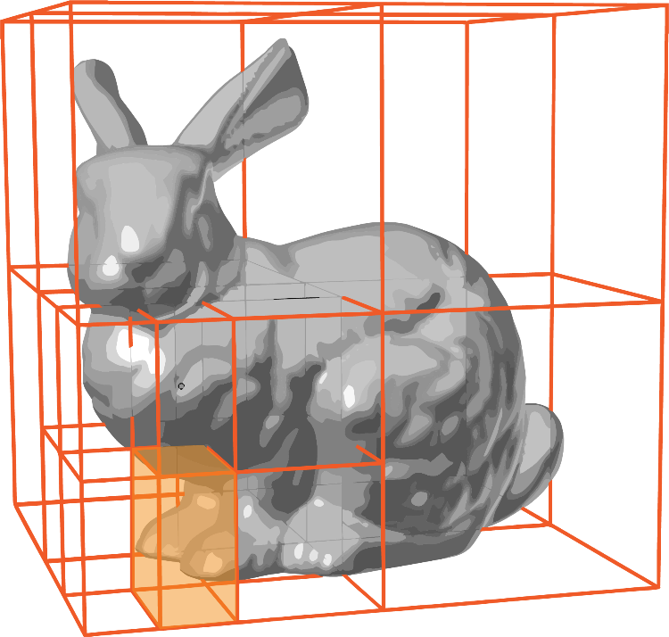
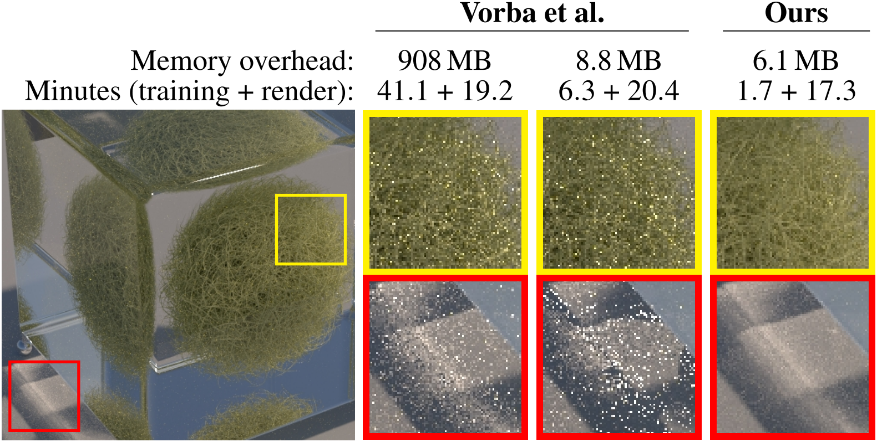
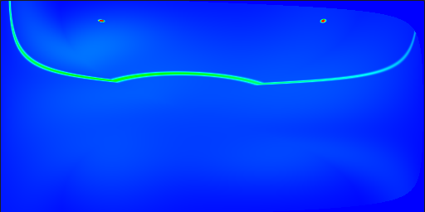
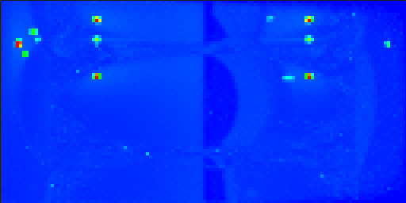
Other Contributions
Spatial adaptivity
Geometry-independent parametrization
            Interactive results inspection tool
Notes:
I’ll briefly mention some of our other contributions we have in our paper.
First, we provide a simple, yet robust strategy for subdividing our guiding distribution spatially. In this presentation I only explained our directional refinement scheme in detail.
Next, in our method, unlike most previous work, we use a geometry-independent parametrization for our guiding distributions, which helps us with robustness and low memory usage.
Of course, we have additional comparisons and evaluations against other techniques, and in fact, we packaged them up in an interactive viewer that runs in your browser if you want check them out in more detail.

Slide 56


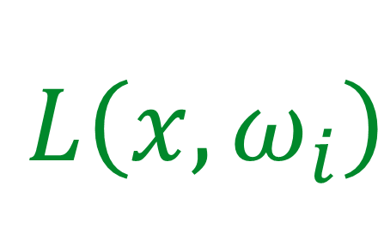
Conclusion
Directional quadtree for incident radiance
Equal-energy partitioning
Iterated simultaneous training and rendering via path tracing
Interactive rendering preview
Optimal training / rendering tradeoff
Simple to implement
$L\left(x,ω_{i}\right)$
Incident
+
$$x$$
Notes:
Let’s recap the main contributions we’ve seen.
First, we’ve seen the quadtree for storing the directional component of incident radiance. It has a simple subdivision heuristic, which leads to an equal-energy partitioning of the directional domain and a well-behaved memory footprint; under 20 megabytes in all our tests.
Next, we looked at how we combine training and rendering and iterate over it. This allowed us to not only get a quick rendering preview from the very start of the algorithm, but also to automatically determine an optimal tradeoff between training and rendering budgets.
I think it is important to highlight, that our entire algorithm is very simple to implement and requires almost zero tunable parameters. We know of a certain group which implemented our algorithm within a week.

Slide 57
Thank you for your attention!
Acknowledgments:
            Brian McWilliams
            Ryusuke Villemin
            Marios Papas
            Sebastian Herholz
            Jay-Artist (Blendswap)
            Ondřej Karlík
            Olesya Jakob
            Fabrice Rousselle
Disney Confidential - Do Not Distribute

Slide 58
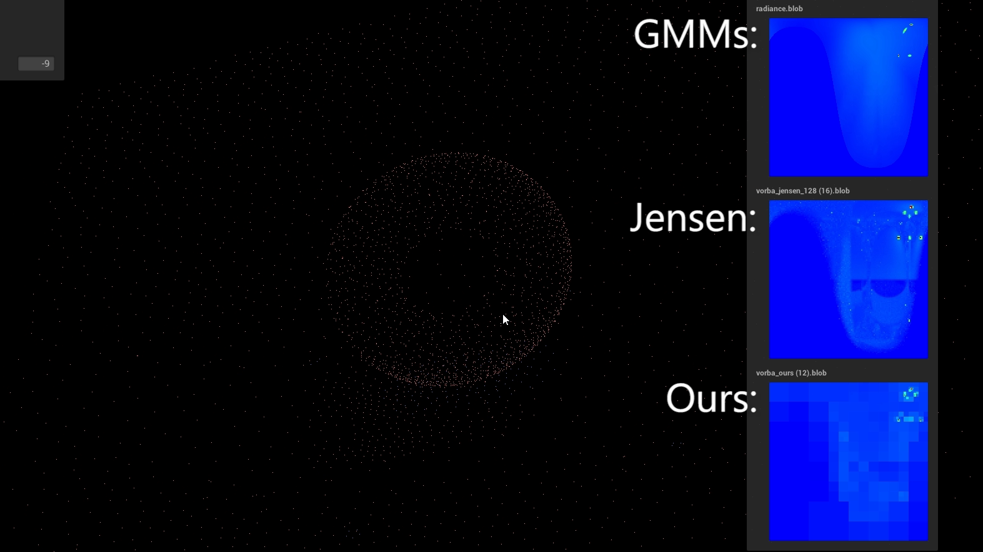
Questions?
Disney Confidential - Do Not Distribute
Notes:
Let me demonstrate this. Here on the left side you can see a bunch of positions for which we trained the gaussian mixture models and our quadtrees for 5 minutes in total. We also trained Jensen’s regular grid structure, but for 10h, to obtain a somewhat reasonably converged high-resolution reference.
On the right you can see visualizations of these distributions at the current location of the mouse cursor.
…
When looking at the gaussian mixture models in the top, flickering is clearly visible, and most importantly, the narrow high-energy peaks are not reliably captured.
Our quadtrees on the other hand, approximate the high-energy peaks reliably, and with very high precision. If one were to zoom-in, one your see that the finest-scale resolution of our quadtrees is much more detailed than Jensen’s grids used here despite using 100 times less memory.

Slide 59

Questions?
Disney Confidential - Do Not Distribute

Slide 60
What is Path Tracing?
Notes:
We’re looking at the problem of simulating light transport by path tracing, where we generate lots of random light paths---trajectories light can take from a light source to the camera---and averaging them in a smart way such that we converge to the final image. Our goal is to make this convergence as fast as possible, which means constructing lots light paths that contribute significantly to the final image.

Slide 61
How to Generate Paths?
Notes:
So how can we construct light paths with high contributions? Let’s look at the simplest possible approach: Picking random directions.
So starting from the camera we hit the ceiling, then we pick a random direction, hit the table, hit the ceiling again, now the floor, the table, the ceiling, and finally we hit the light by chance. Now this light path seems unnecessarily complex, and as you can all probably tell already, it’s not very representative of those light paths which carry most of the energy from the light source to the camera. But let’s see how this method does on an actual image!

Slide 62

Notes:
Here we rendered the scene from before for 5 minutes using random directions when constructing paths. As expected, it looks pretty bad.

Slide 63
Complex Geometry

Slide 64



What is Path Guiding?
$L\left(x,ω_{o}\right)=\int{L\left(x,ω_{i}\right)f\left(x,ω_{o},ω_{i}\right)\cos\left(θ_{i}\right)ⅆω_{i}}$
Outgoing
Incident
BSDF
Foreshortening
$ω_{o}$
$$x$$
Notes:
So let’s look at path guiding a bit more formally. Our goal is to evaluate the radiance function L at the shading location x and in the direction towards the camera $ω_{o}$.
The way we evaluate this function is with a recursive integral over all incident directions $ω_{i}$ . The integrand in this case is the product of the incident radiance, again described by L, the BSDF, telling us how much of the incident light is reflected by the towards $ω_{o}$, and lastly the foreshortening term, which captures that light arriving an angle is spread over larger areas.
Since we are estimating this integral via a Monte Carlo simulation, i.e. path tracing, we can minimize the variance by importance sampling this full product. In practice, of course, we would need knowledge of L in order to perform this importance sampling, and that would mean we would already have the solution in the first place. However, we can precompute a coarse version of the integrand in a training step and use that instead to guide the construction of light paths.

Slide 65

What is Path Guiding?
$L\left(x,ω_{o}\right)=\int{L\left(x,ω_{i}\right)f\left(x,ω_{o},ω_{i}\right)\cos\left(θ_{i}\right)ⅆω_{i}}$
Outgoing
Incident
BSDF
Foreshortening
5D
7D
$ω_{o}$
$$x$$
Notes:
Traditionally, this is even further simplified by precomputing only the radiance function L and disregarding the BSDF and the foreshortening term. When path tracing, importance sampling from the precomputed version from L can then be combined with BSDF sampling via multiple importance sampling or in some special cases even with on-the-fly product sampling.
So why are we doing this? Why disregard the BSDF and the foreshortening term for the precomputation?
The first argument I’d like to give is the dimensionality of the function we need to tabulate. When considering only the incident radiance L, then our function is 5D. Three dimensions come from the position x, and the other two dimensions come from the incident direction $ω_{i}$.
If we also considered the BSDF, then our dimensionality would increase to 7D, because the BSDF additionally depends on the outgoing direction $ω_{o}.$

Slide 66

What is Path Guiding?
$L\left(x,ω_{o}\right)=\int{L\left(x,ω_{i}\right)f\left(x,ω_{o},ω_{i}\right)\cos\left(θ_{i}\right)ⅆω_{i}}$
Outgoing
Incident
BSDF
Foreshortening
5D
7D
$ω_{o}$
$$x$$
Notes:
Just to demonstrate, here you see how the BSDF changes as we vary $ω_{o}$ whereas the incident radiance stays the same.

Slide 67
What is Path Guiding?
$L\left(x,ω_{o}\right)=\int{L\left(x,ω_{i}\right)f\left(x,ω_{o},ω_{i}\right)\cos\left(θ_{i}\right)ⅆω_{i}}$
Outgoing
Incident
BSDF
Foreshortening
5D
7D
$ω_{o}$
$$x$$
Notes:
The second argument for removing the BSDF, which now also concerns the foreshortening term, is dependence on the local geometry, or more specifically, the surface normal.

Slide 68
What is Path Guiding?
$L\left(x,ω_{o}\right)=\int{L\left(x,ω_{i}\right)f\left(x,ω_{o},ω_{i}\right)\cos\left(θ_{i}\right)ⅆω_{i}}$
Outgoing
Incident
BSDF
Foreshortening
5D
7D
$ω_{o}$
$$x$$
Notes:
Again, to demonstrate, here I am tilting the ground, which affects the BSDF and the foreshortening term whereas the incident radiance remains almost exactly the same.

Slide 69
What is Path Guiding?
$L\left(x,ω_{o}\right)=\int{L\left(x,ω_{i}\right)f\left(x,ω_{o},ω_{i}\right)\cos\left(θ_{i}\right)ⅆω_{i}}$
Outgoing
Incident
BSDF
Foreshortening
5D
7D
$ω_{o}$
$$x$$
Notes:
The second argument for removing the BSDF, which now also concerns the foreshortening term, is dependence on the local geometry, or more specifically, the surface normal.

Slide 70


What is Path Guiding?
$L\left(x,ω_{o}\right)=\int{L\left(x,ω_{i}\right)f\left(x,ω_{o},ω_{i}\right)\cos\left(θ_{i}\right)ⅆω_{i}}$
Outgoing
Incident
BSDF
Foreshortening
5D
7D
$ω_{o}$
$$x$$
$$x$$
Notes:
The reason why we want to avoid this dependency on the surface normal is, that the surface normal can vary rapidly spatially. Imagine we weren’t looking at flat ground, but a geometrically complex object like hair, or a bump-mapped texture. Then avoiding this dependence on the surface normal makes the function we need to tabulate significantly smoother and well behaved.

Slide 71
What is Path Guiding?
$L\left(x,ω_{o}\right)=\int{L\left(x,ω_{i}\right)f\left(x,ω_{o},ω_{i}\right)\cos\left(θ_{i}\right)ⅆω_{i}}$
Outgoing
Incident
BSDF
Foreshortening
5D
7D
$ω_{o}$
$$x$$
$$x$$
Notes:
The reason why we want to avoid this dependency on the surface normal is, that the surface normal can vary rapidly spatially. Imagine we weren’t looking at flat ground, but a geometrically complex object like hair, or a bump-mapped texture. Then avoiding this dependence on the surface normal makes the function we need to tabulate significantly smoother and well behaved.

Slide 72
What is Path Guiding?
$L\left(x,ω_{o}\right)=\int{L\left(x,ω_{i}\right)f\left(x,ω_{o},ω_{i}\right)\cos\left(θ_{i}\right)ⅆω_{i}}$
Outgoing
Incident
BSDF
Foreshortening
5D
7D
$ω_{o}$
$$x$$
$$x$$
Notes:
The reason why we want to avoid this dependency on the surface normal is, that the surface normal can vary rapidly spatially. Imagine we weren’t looking at flat ground, but a geometrically complex object like hair, or a bump-mapped texture. Then avoiding this dependence on the surface normal makes the function we need to tabulate significantly smoother and well behaved.

Slide 73

The Spatio-Directional Tree (SD-Tree)
Spatial binary tree
Directional quadtree
Notes:
Bringing these two pieces together: Every leaf node of the spatial binary tree contains its own directional quadtree. Uncreatively we call this data structure the spatio-directional tree, or SD-Tree in short.
When path tracing, one would simply traverse the spatial tree to the leaf containing the current path vertex, and then its stored directional quadtree can be used for importance sampling, for storing a new monte carlo sample to refine it, or to simply evaluate the function.
While we do adaptively refine both of these trees while rendering, I would like to focus on the refinement of the directional quadtree in this presentation, as I believe it is more interesting.

Slide 74
High Frequency Shadows
$L\left(x,ω_{i}\right)$
Incident
$$x$$

Slide 75
High Frequency Shadows
$L\left(x,ω_{i}\right)$
Incident
$$x$$

